Slide 1
Learning conversations

Slide 2
Lead Mentor and Trainee: Weekly Development Meeting​ (WDM)
Lead Mentor with trainee​
One hour a week, timetabled​
Review progress, plan progression and set targets​
Monitor EPS tasks (primary and secondary), and Subject Framework Tasks (primary)​
Complete WDM Record together online. The form provides guidance about what to discuss, there is a different version of the WDM record in the Developing Independence Phase.

Slide 3
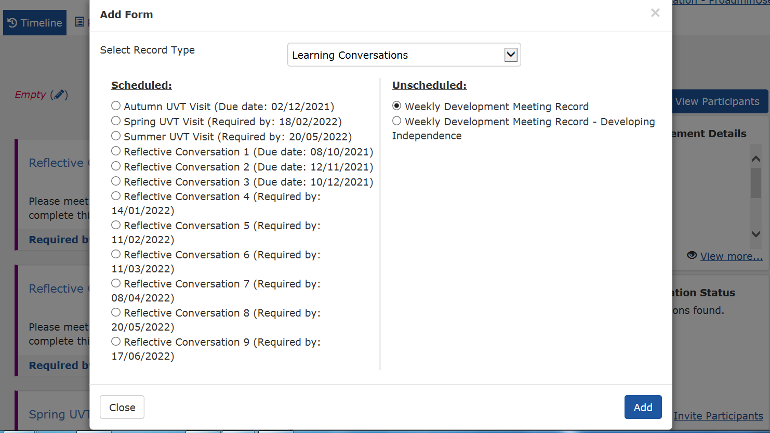
Weekly Development Meeting​ (adding the template)
Notes:
Trainee adds the Weekly Development Meeting record template to the IDP
Go to the top of the timeline click +
Use the drop down box to highlight Learning Conversations
Go to Unscheduled
Click on Weekly Development Meeting Record
Click Add
* If in the DI Phase choose the WDM for Developing Independence

Slide 4
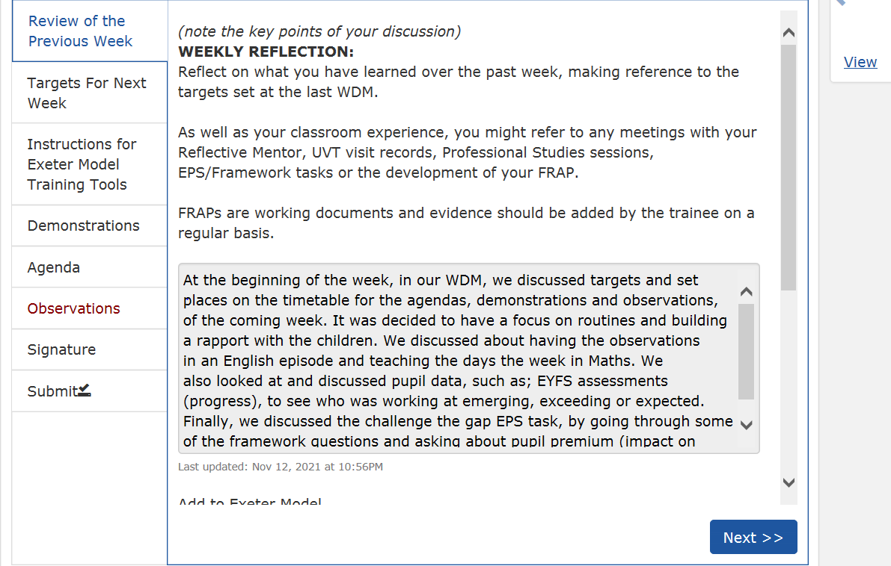
WDM (Trainee weekly reflection)
Click into the WDM Record
Prior to the WDM the Trainee completes a review of the previous week called a Weekly Reflection
The Weekly Reflection is used a guide for the WDM conversation to review progress
Notes:
Click into the WDM Record
Trainee completes a review of the previous week called a Weekly Reflection
Trainee prepares this in advance of the meeting

Slide 5
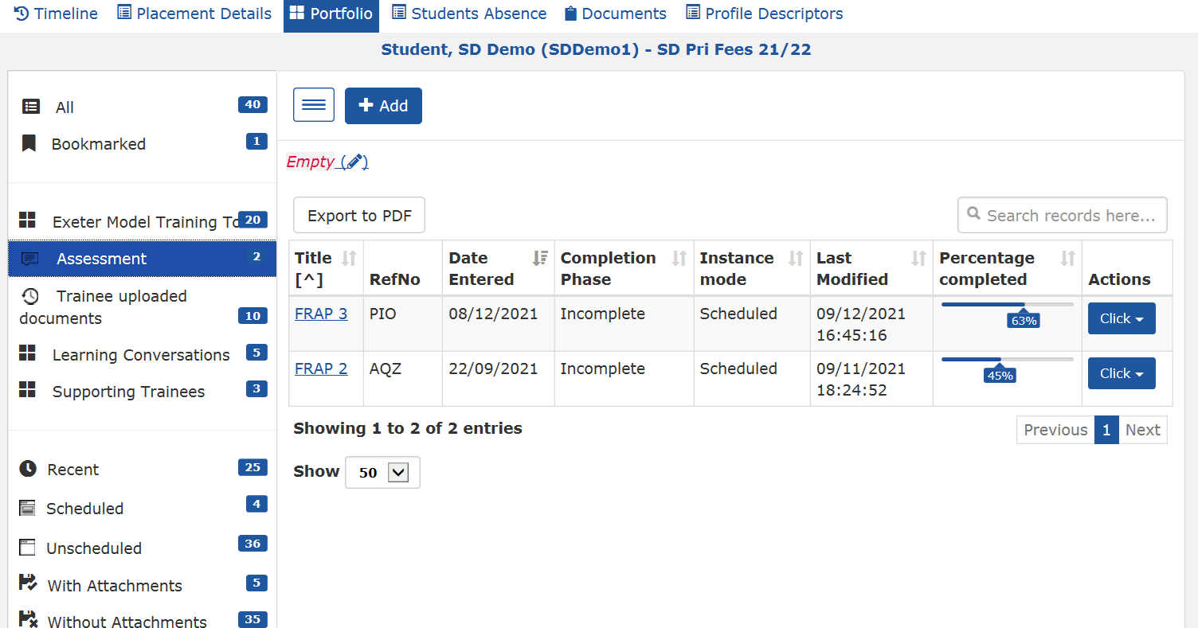
WDM (review portfolio evidence / FRAP)
During the WDM Trainee should guide LM through the IDP to show progress against Profile Descriptors
LM can view contents of the portfolio by clicking on Portfolio
Click on Assessment to view FRAPs or use the alternative tabs on the left to filter documents in the portfolio

Slide 6
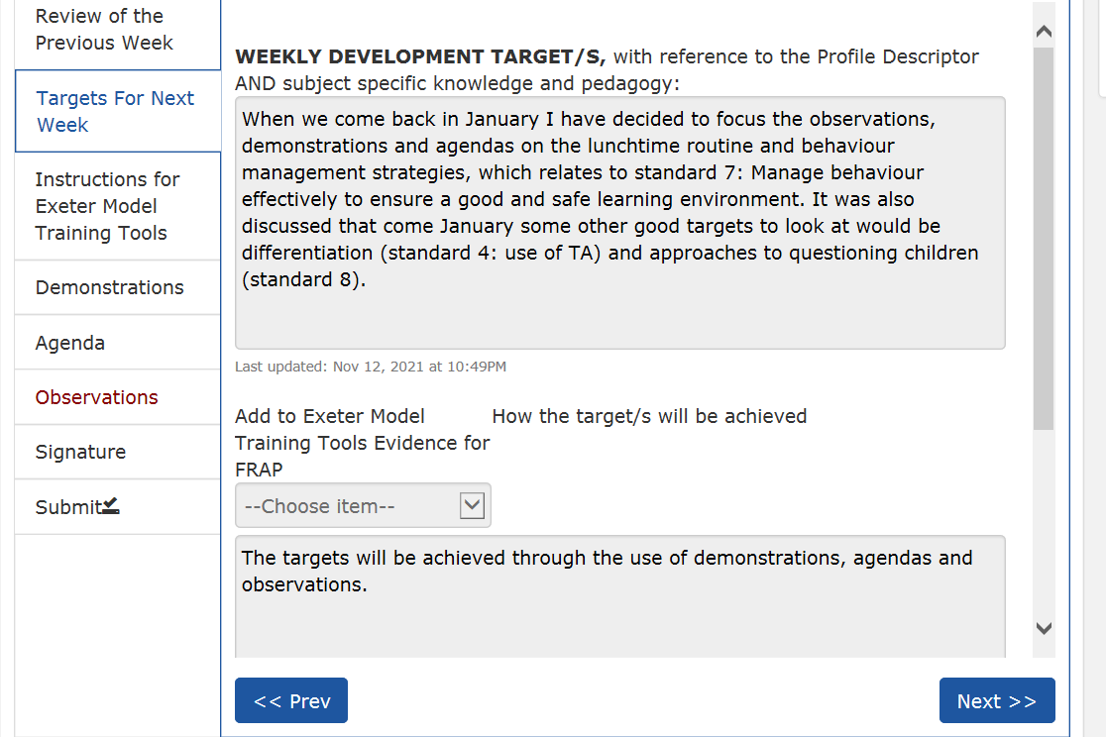
WDM (target setting)
Trainee writes targets for next week
Trainee lists how targets will be achieved
Trainee lists which tools will be used to demonstrate progress with the targets.
Click next

Slide 7
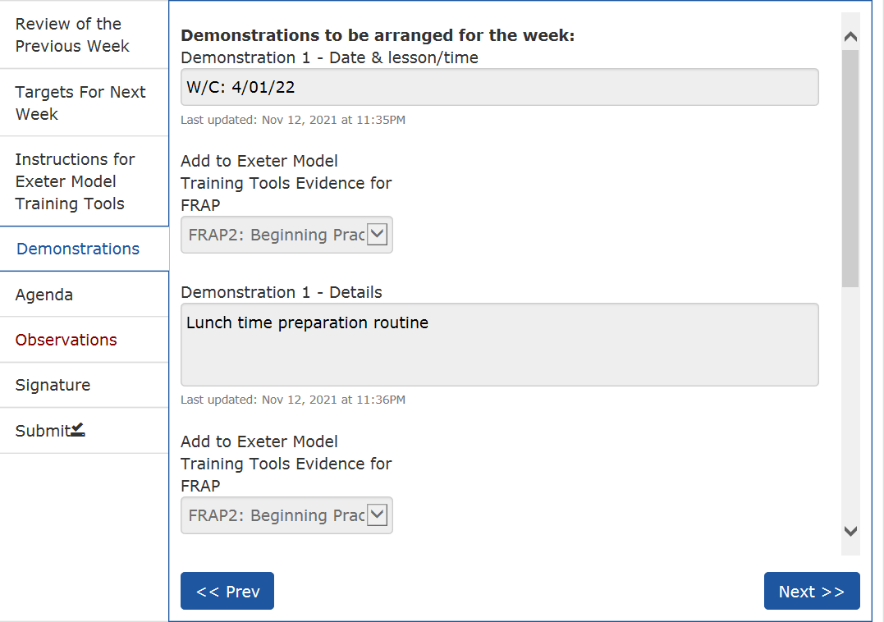
WDM (Planning the week ahead)
Trainee decides dates and focus for Demonstrations and Agendas next week in agreement with the LM
Click next

Slide 8
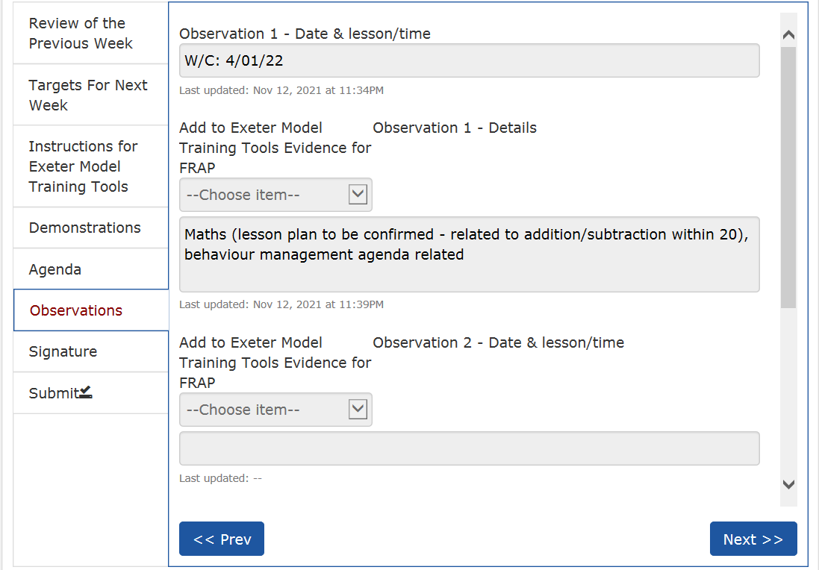
WDM (Planning the week ahead)
Trainee and LM agree dates and focus for lesson observations the following week
Click next

Slide 9
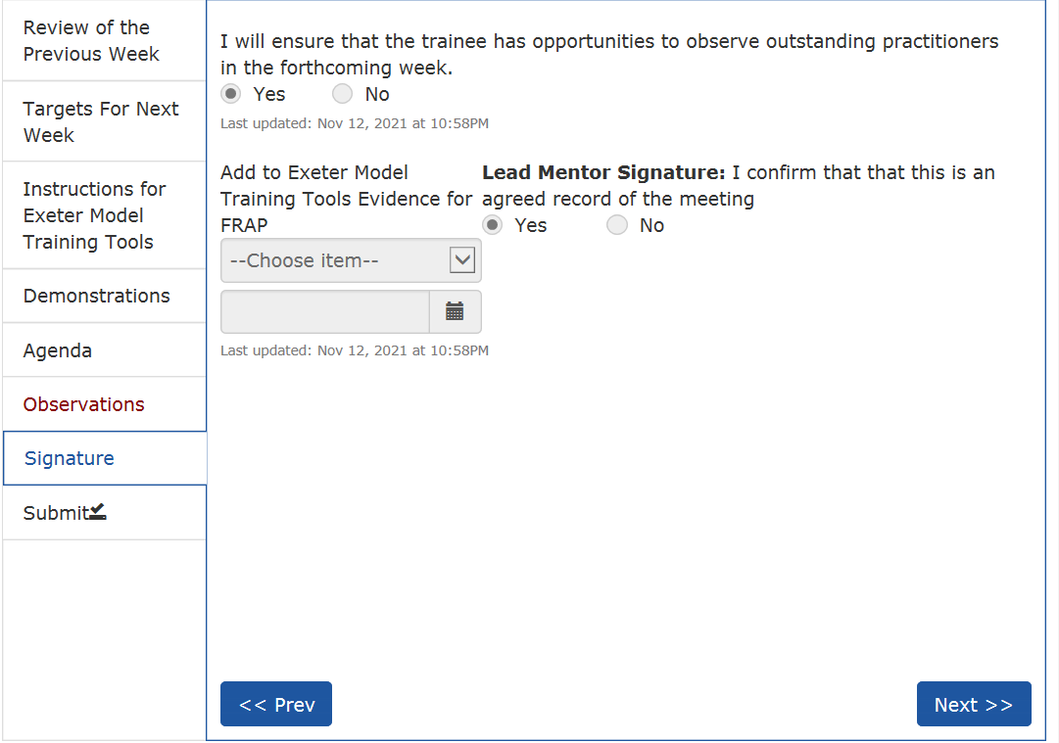
WDM (submitting the record)
LM confirms they will provide opportunities to observe outstanding practice
LM confirms they agree the record of the meeting
If the WDM contains evidence for the phase then link to associated FRAP using the drop down box
LM dates the record
Click next and submit

Slide 10
Reflective Mentor and Trainee: Reflective Conversation
Three one-hour-long meetings per term, one-to-one with Reflective Mentor.​
Documentation to be on IDP prior to the meeting:​
2 selected annotated and evaluated agendas + associated lesson plans, pupils’ work etc. (Focused Reflections in the DI phase)​​
FRAP – to discuss progress
Process:​
Develop critical evaluation based on evidence in the IDP for FRAP and agendas, using Exeter Model Framework ​for promoting reflective conversation
Notes:
Trainee should select 2 agendas to talk through with their Reflective Mentor and inform them which ones these will be prior to the meeting. Trainee should present all progress towards the FRAP to enable to RM to identify any targets to continue progress, which the trainee with record.

Slide 11
Notes:
Go to the IDP open the Reflective Conversation in the Portfolio (or add if required)
Reflective Conversations with the Reflective Mentor should:
Support trainee completion of the phase and review relevant FRAP –
Review the live FRAP document to allow a conversation around progress in the phase
Discuss one or more Agendas (Focused Reflection in the DI Phase) and their evaluations using the Exeter Model Framework as a frame for discussion.
Reflective Mentor will support trainee to reflect on progress, this may involve looking at the Weekly Development Meeting Records and other documentation in the IDP and Teaching Files
RM supports the trainee to decide when they have met the requirements of the phase

Slide 12
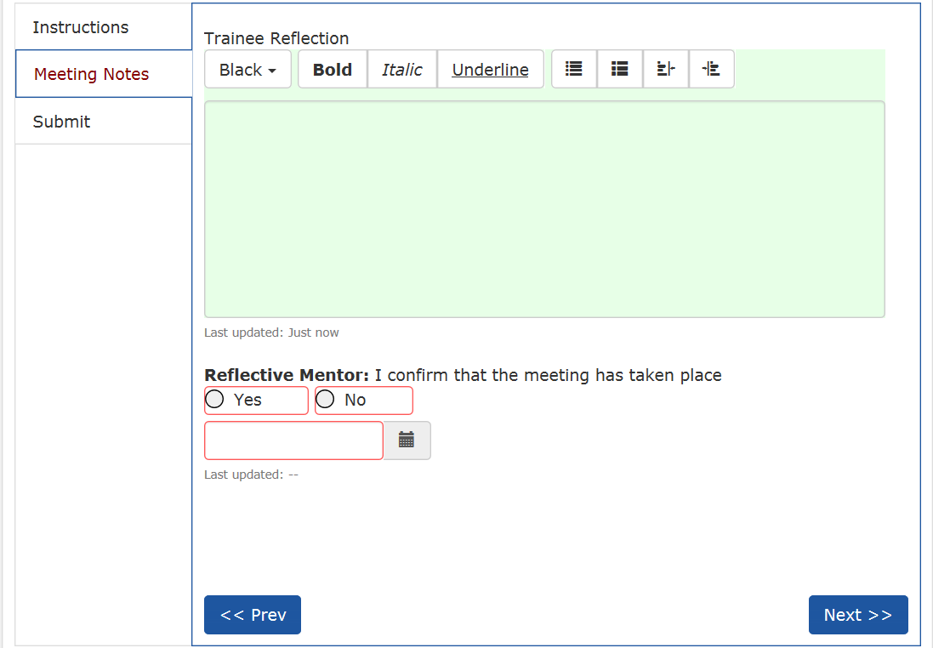
Reflective Conversation
Trainee makes notes while in the Reflective conversation
Reflective Mentor must confirm the meeting has taken place
RM dates when the meeting took place.
Click Next
Go to the next tab and click submit
Notes:
Click into the RC template to begin
The trainee writes notes from the meeting
The Reflective Mentor reviews all progress to date and signs and agrees the content of the meeting

Slide 13
UVT and Trainee: the UVT Visit
Joint observation of trainee by UVT and Lead Mentor
Learning Conversation between UVT and trainee, including checking IDP and discussing progress
UVT meets with Lead Mentor, Reflective Mentor and ITEC where possible​
UVT checks trainee progress and also quality assures placements​. This will involve observing Lead Mentor giving feedback to trainee following observation
UVT will ask about Professional Studies Programme​
UVT can offer advice/ answer any questions schools and trainees have about the training​

Slide 14
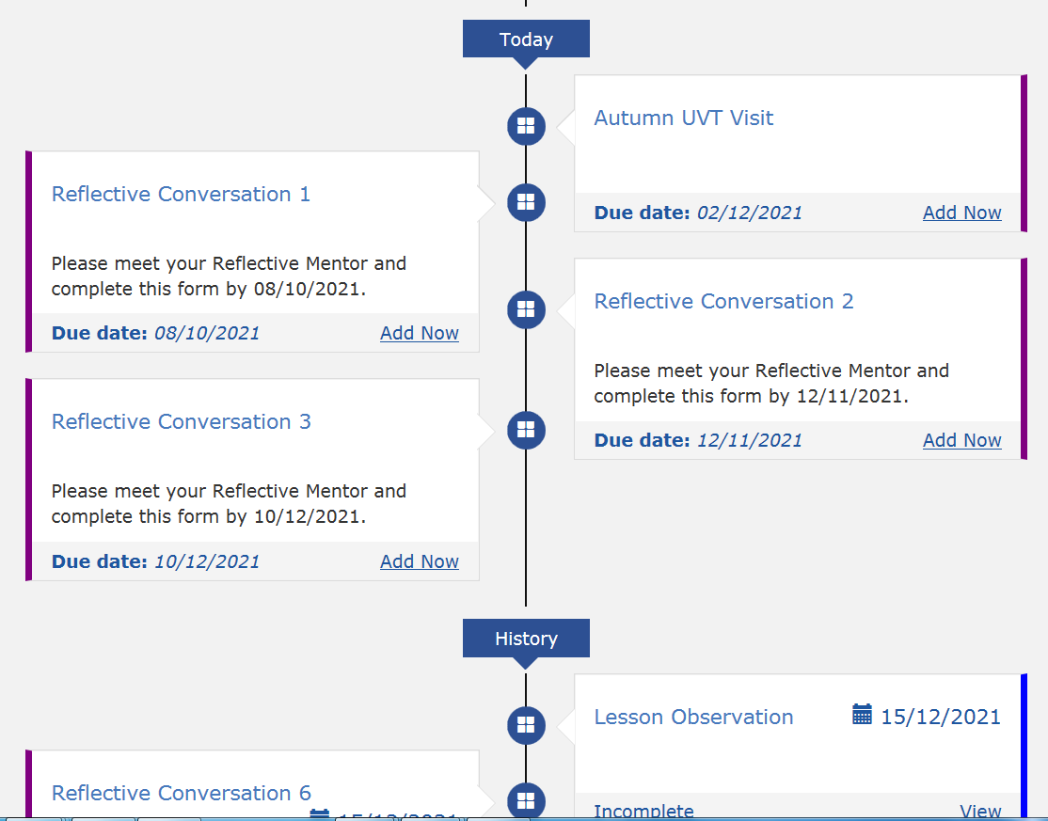
UVT visit
Trainee should provide the UVT with a lesson plan before the observation
UVT completes the visit record tinthe trainee time line

Slide 15
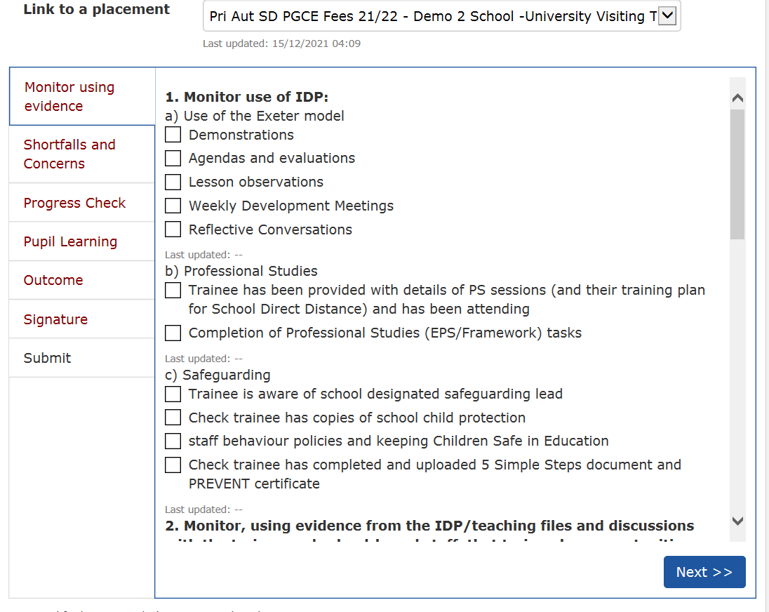
UVT visit
UVT meets with the trainee and checks the use of the Exeter Model Tools in the IDP
UVT checks the Professional Studies provision from school
UVT checks evidence of completing mandatory training. (safeguarding, PREVENT etc.)
UVT reviews evidence in the IDP
UVT completes section 2 of the record for Quality Assurance including specifics of teaching exposure and fundamental skills

Slide 16
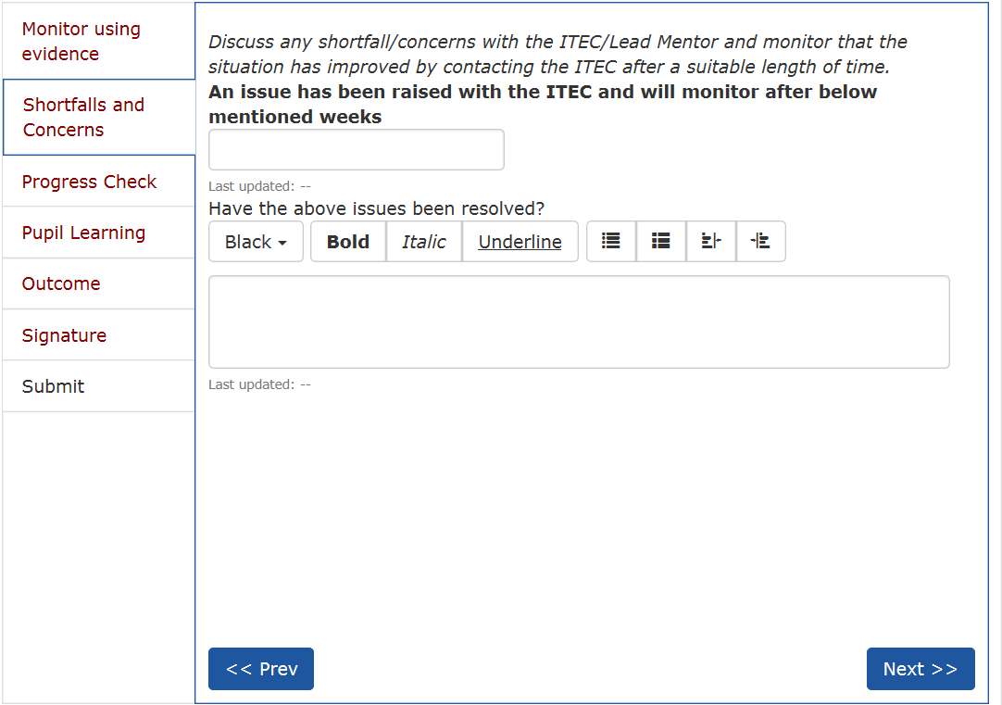
UVT visit
If the UVT has any concerns regarding the progress of the trainees the issues are noted in the shortfalls and concerns section of the record.
Any issues noted will be raised to the ITEC for action

Slide 17
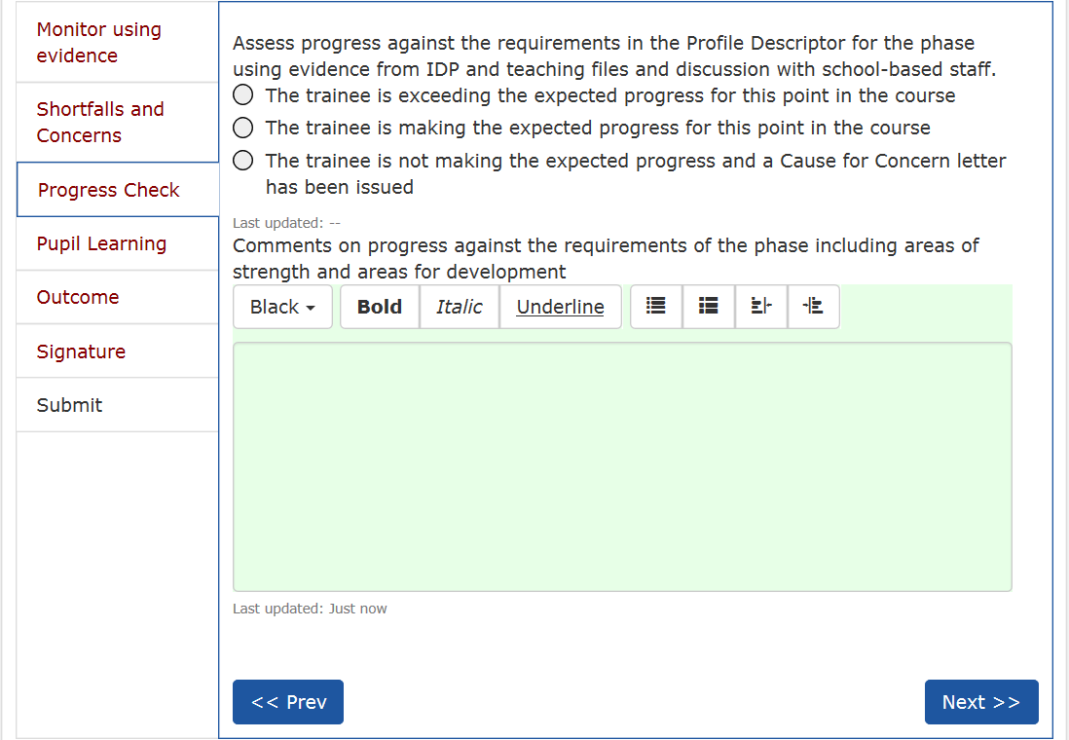
UVT visit
The UVT check progress from IDP Records. Observation and discussion with Mentors and assess progress against the Profile Descriptor for the phase.
UVT comments on the Trainees progress including Strengths and areas for Development
UVT clicks Next

Slide 18
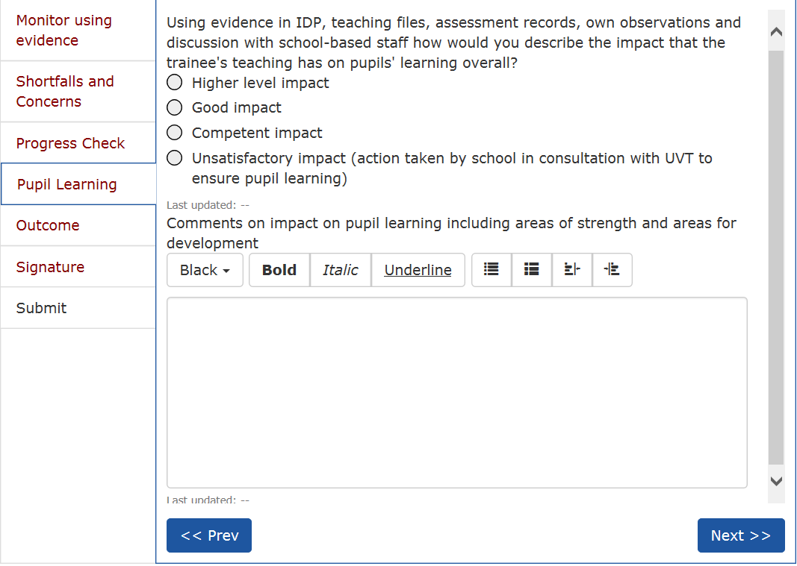
UVT visit
Based on the evidence acquired at the UVT visit the UVT describes the Impact on pupils learning overall.
UVT comments on pupil learning including areas of strength and areas for development
UVT clicks Next

Slide 19
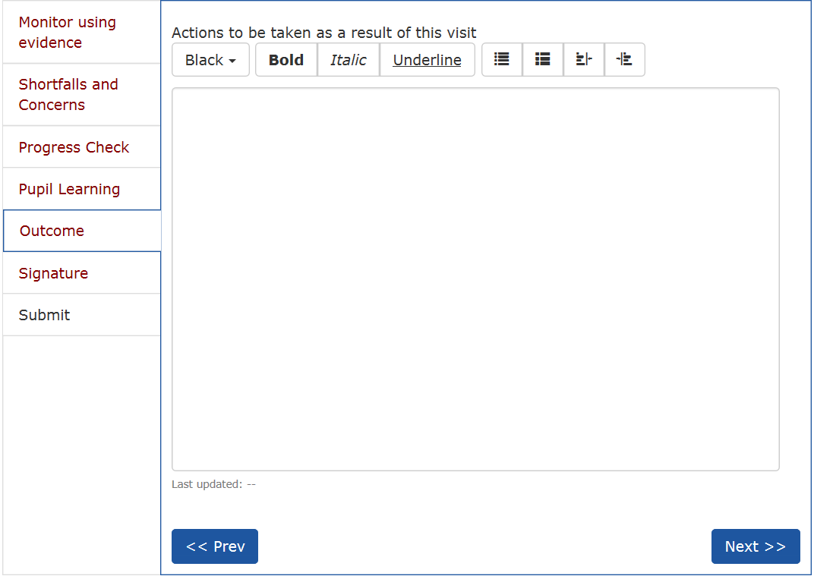
UVT visit
UVT writes any Action Points necessary from the visit to ensure trainee progresses e.g. they may issue a TSP or CFC if trainee requires extra support.
UVT clicks Next

Slide 20
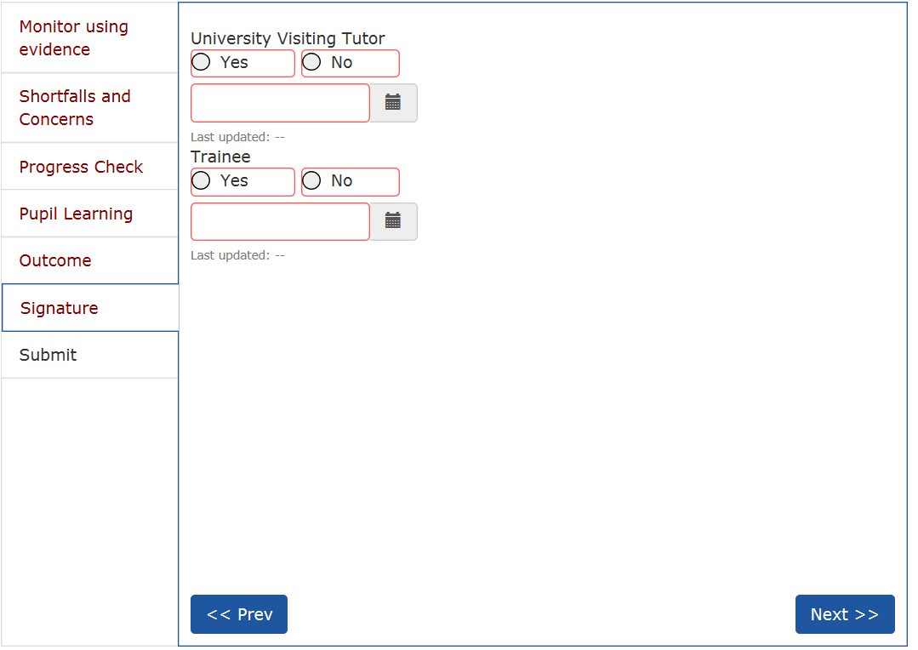
UVT visit
UVT signs and dates the UVT visit record.
Trainee must also sign and date the record
UVT clicks Next
UVT then clicks Submit

