Slide 1
The exeter model framework

Slide 2
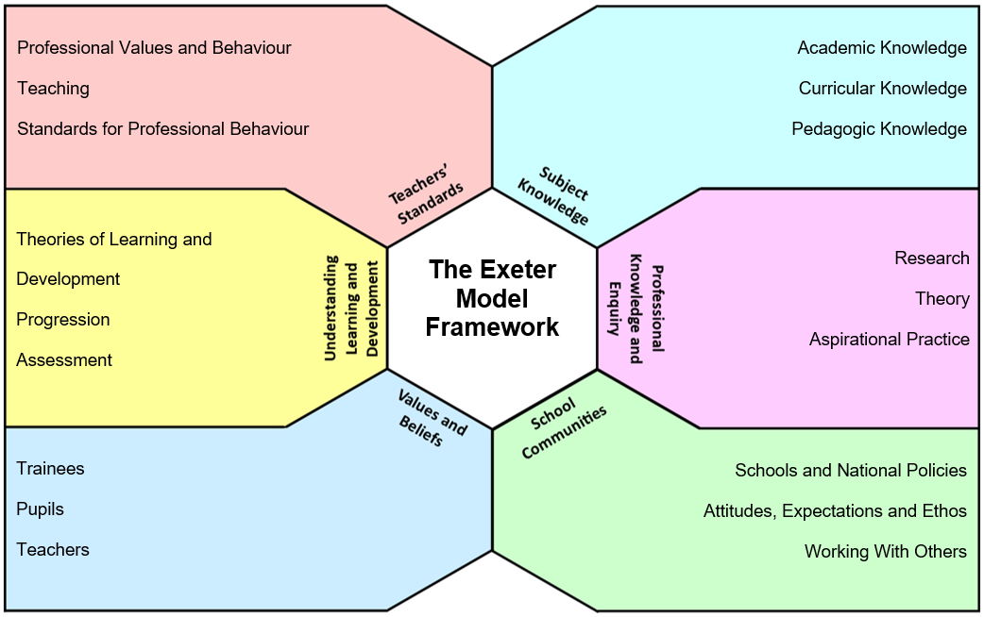
The Exeter Model Framework
Notes:
To encourage critical conversation about classroom practice and support the process of reflective evaluation, an ‘Exeter Model Framework’ is provided. This framework identifies a range of influences which may affect planning, teaching and assessment and groups them under these headings
Trainees are introduced to this framework during their taught course and should be familiar with using this to analyse issues around teaching by the time they attend the school placement.
it provides a structured framework to use when talking about teaching. It is designed to aid teachers in reflecting on their work in relation to a specific aspect of practice by drawing attention to a number of interlinked aspects of the context in which they are working. The Framework prompts teachers to interrogate and discuss their practice by asking questions of themselves and each other in relation to their values and beliefs, their knowledge about their subject, about teaching, and about learning, the school ethos and community, and education policy.

Slide 3
THE EXTER MODEL FRAMEWORK
The Framework may be used in:​
Reflective Conversations with mentors or tutors
Planning​
Evaluating​ practice
Completing Framework tasks
​
For all trainees it provides a structure for some of the EPS school based tasks, such as EAL, Challenging the Gap, Interpreting Data and the optional Leadership strand.​
For primary trainees it also provides a structure for the Subject Framework Tasks for Maths, Modern Languages and PE.​
For distance trainees it provides the structure for tasks ​
focusing on behaviour, EAL, assessment, SEND ​
and theories of learning.​
​

