Slide 1
The Taught Curriculum – school direct distance

Slide 2
In all of our ITE curricula, the Core Content Framework (CCF) is covered in full as a minimum entitlement, with each subject and phase-specific curriculum map demonstrating for trainees and mentors where the CCF is taught, how it is contextualised for the relevant subject and phase, and what else is included, building on this minimum entitlement to ensure thorough, research-informed, subject-specific training.
Notes:
The Core Content Framework from the DfE. Split into…
Learn that… statements are informed by the best available educational research; references and further reading are provided below.
Learn how to… statements are drawn from the wider evidence base including both academic research and additional guidance from expert practitioners.
The learn that statements are covered by our taught curriculum – including seminar days and online materials - and the learn how to elements are covered through use of the Exeter training tools in school placements. These will be covered in more depth a bit later.
However, the course goes significantly beyond the CCF in lots of ways – including subject specific input (the CCF is almost all generic), a deeper understanding of socio-cultural perspectives on learning, and a much deeper engagement with research and understanding of how research can inform practice.

Slide 3
School Direct Distance PGCE programme
Professional Learning
Education & Professional Studies (EPS)
Subject & Curriculum Studies (SCS)
Notes:
30 creds from SCS
30 creds from EPS
Assignments (7,500 words total – 1,500 formative, 6000 summative)
SBW assessed through a portfolio of evidence which you’ll hear more about later, but the written assignments can also form part of that evidence – they link theory to practice rather than being separate.

Slide 4
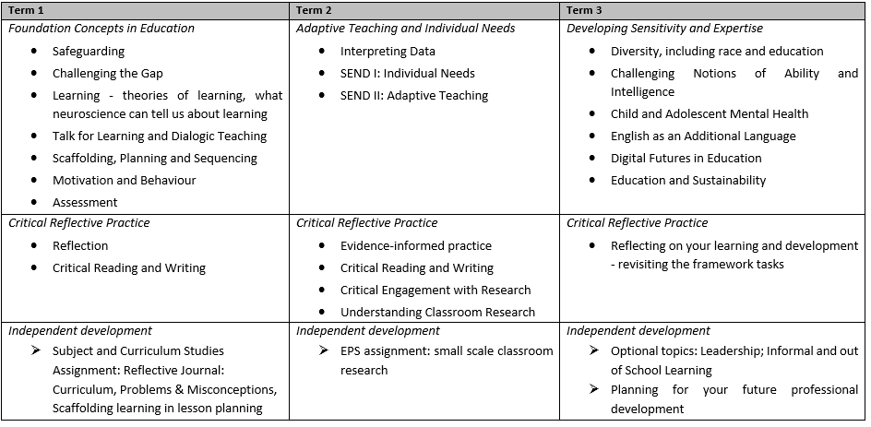
SCS & EPS Modules
Notes:
The SCS and EPS modules are studied through online learning (1 day per week needs to be timetabled for this for ALL trainees) with seminar days about once per half term which will help to anchor these learning and provide some subject-specific pedagogical training.
The topics are sequenced by term to progress from fundamental concepts in term 1, into adaptive teaching in term 2, and more critical, sensitive issues in term 3.
NB this example is the primary sequence – secondary is very similar but EAL is in term 2.
In term 1 they will be exploring the nature of learning, scaffolding and sequencing learning, scientific and sociocultural theories of learning, the role of talk, motivation, behaviour and assessment – all fundamental knowledge about teaching and learning.
They will also be developing their ability to think, read and write critically and reflectively.
This is assessed in their first assignment, for which they need to write about an aspect of the curriculum (one subject or subject strand in primary; the KS3 curriculum in secondary –or KS4 where the subject isn’t taught at KS3 or they are in a KS4-5 institution); about typical problems or misconceptions in the learning of that subject, and design, teach and critically evaluate a lesson within that curriculum area.
In term 2 they will be exploring adaptive teaching – including the use of data to inform lesson planning, and working with individual needs - SEND and EAL, as well as deepening their engagement with evidence-informed practice through developing their own very focused critical investigation of an issue in the classroom (their second assignment).
In term 3 there are no M level assignments (to allow them to focus on classroom practice and to reflect the increasing hours demand) but the course continues with issues focused on expanding and deepening their understanding and criticality – CAMH, what we mean by ‘ability’ and ‘intelligence’, digital and online learning.
Please talk to them about what they’ve been doing on the university taught course - trainees really value the opportunity to make links between their learning and their experiences on placement.

Slide 5
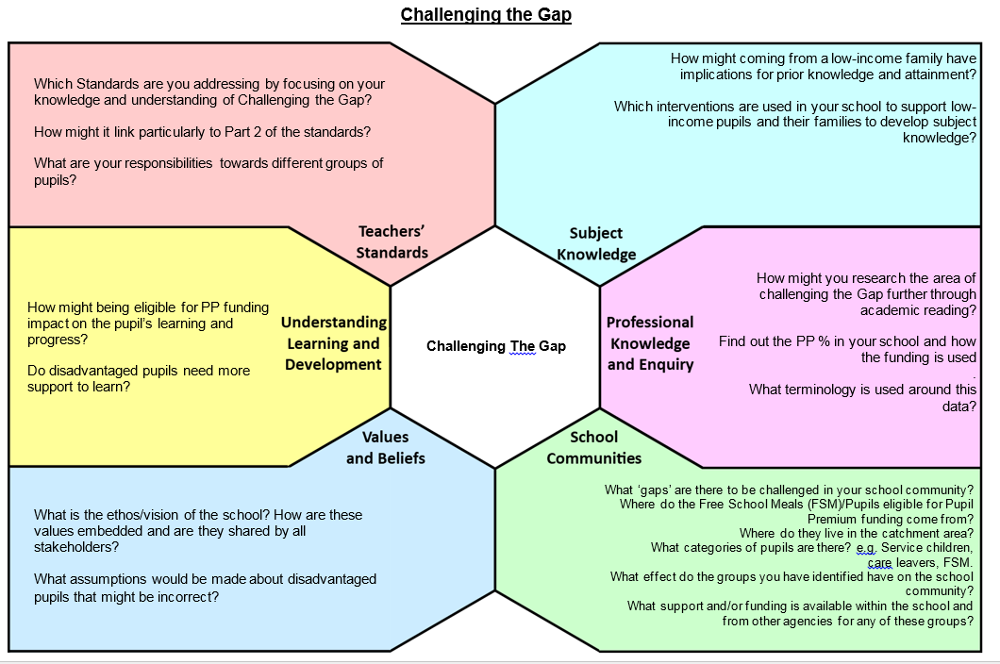
Framework Reflections
Challenging the Gap
Curriculum*
Learning
Behaviour
Assessment
Interpreting Data*
SEND*
EAL
Maths* (primary only)
Leadership (optional)
*must be done individually
Notes:
These reflections prompt trainees to consider key issues from a variety of perspectives, and are used as the main source of written evidence of their engagement with the university taught components of the course (alongside their assignments).
They aim to help trainees link theory to practice, and often involve activities in school (e.g. observing pupils, planning lessons, analysing school data).
They all come with material in the form of recorded mini-lectures, key reading, videos. The idea is that trainees look at what is happening in their school, and link this to the wider picture of research evidence, policy and experiences from other contexts.
Trainees are actively encouraged to collaborate on these tasks – to discuss their different experiences, share out key reading and discuss what they’ve read. The slide indicates the only tasks which must be done individually.
They are not assessed and can be written in note form, but do provide evidence of knowledge and understanding for QTS and can be a valuable starting point for Mentor conversations – please ask to see and talk about them.
-the Curriculum reflection is part of their first formative assignment, and involves them interviewing a member of staff about an aspect of the curriculum
-the Interpreting Data reflection is used as quality assurance of their fundamental Maths (their ability to understand and use data)
Please do ask to see and talk about their reflections – e.g. they could form the basis of part of a discussion with their reflective mentor.
They are excellent evidence for QTS – particularly SEND and EAL for S5, and Maths for S3 – as these also involve observing, planning, teaching and evaluating.

Slide 6
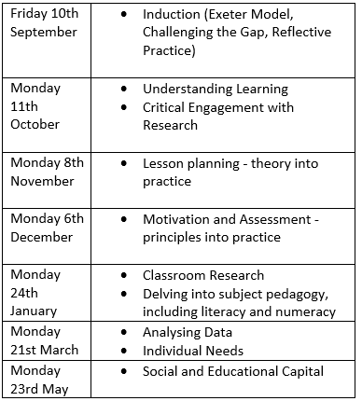
University Seminar Days (online)
P
R
I
M
A
R
Y
SECOND
A
R
Y
Lead Mentors attend 3.45-4.30 on Secondary Seminar Days (not induction)
Notes:
University seminar days will all be live online, providing an opportunity to anchor, develop and reflect on trainees’ online learning and also provide additional seminar input on key topics.
In primary, this includes particular subject specific seminars, which look at the pedagogy of different subjects. Trainees will start as a big group with lead input (there are approx. 80 trainees), then will split into groups of c.27 for seminar sessions).
In secondary we have a small group of about 9 trainees working in different subject areas. For us to anchor the discussion in the subject we need Lead Mentors to join their trainees (online) 3.45-4.30 for each seminar day. This will give you the chance to talk to your trainee about what they’ve been learning on the day from a subject-specific perspective (and will also keep you up to date with what they’re doing and give you the chance to ask any questions).

Slide 7
Lead School Training Plans
Trainees will all have a training plan created by their Lead School.
These vary by partner, but will build on the university-taught programme, with sessions on particular subject pedagogies as well as input on core or generic issues e.g. assessment, motivation, SEND etc.
Please do ask your trainees to share their training plans and talk to you about their learning.
Notes:
Again, trainees particularly value the opportunity to talk about and make links between the learning they gain in seminars and their experiences on placement.

