Slide 1
Development in L1 Written Vocabulary between 6 and 14
Phil Durrant
University of Exeter

Slide 2
Vocabulary in children’s writing
Diversity
Density
Sophistication
Lexical richness
Accuracy
Read 2000

Slide 3
Vocabulary in children’s writing
Sophistication
Word length
Frequency
Greco/Latin words
Abstract words

Slide 4
Vocabulary in children’s writing
Sophistication
Word length
Frequency
Greco/Latin words
Abstract words

Slide 5
Previous findings
Use of low-frequency words increases with age?
  Yes: Olinghouse & Leaird, 2009 (US 2nd-4th grade)
  No: Malvern et al, 2004 (UK Key stages 1-3)
Use of low-frequency words positively correlated with grades?
  Yes: Massey & Elliot, 1996; Malvern et al, 2004; Massey et al, 2005; Olinghouse & Leaird, 2009; Ollinghouse & Wilson, 2013; Roessingh et al 2015
Mean word frequency decreases with age?
  No: Crossley et al, 2011 (US 9th-11th grade)
Use of abstract words increases with age?
  Yes: Berman and Nir-Sagiv, 2007 (US 4th-7th-11th grade)
  No: Crossley et al, 2011 (US 9th-11th grade)

Slide 6
Sample for the current study
Years 2, 6 and 9 only
English/Humanities classes only
Exclude texts with > 100 illegible words per 1,000
Exclude poems
Exclude samples more than 1SD from mean word length
Randomly select texts to give equal numbers in each year group

Slide 7
Study Corpus
 | Schools | Writers | Texts | Text Length |  |  |  | Genre
 |  |  |  | Mean | Median | Min | Max | Story | Exposition | Persuasion
Year 2 | 3 | 78 | 219 | 66.6 | 62 | 27 | 131 | 116 | 99 | 4
Year 6 | 4 | 90 | 219 | 284.2 | 261 | 120 | 521 | 114 | 82 | 23
Year 9 | 6 | 189 | 219 | 343.3 | 330 | 181 | 560 | 130 | 59 | 30

Slide 8
TAALES* Indices
Frequency
Ngram frequency/association
Concreteness ratings
*Kyle & Crossley 2014

Slide 9
Frequency/Range: 72 indices each
Range of reference corpora
Separate indices for:
  all words vs. content words vs. function words
  raw frequency vs. log frequency

Slide 10
Combining results from different corpora: frequency
Sub-category | Cronbach’s alpha | Deleted
All words / Raw | .99 | SUBTLEXus (r = .41)
All words / Log | .98
Content words / Raw | .98
Content words / Log | .98
Function words / Raw | .99 | SUBTLEXus (r = .41)
Function words / Log | .98

Slide 11
 | All words / Raw | All words / Log | Content words / Raw | Content words / Log | Function words / Raw | Function words / Log
All words / Raw | 1.00
All words / Log | 0.18 | 1.00
Content words / Raw | -0.15 | 0.61 | 1.00
Content words / Log | -0.27 | 0.80 | 0.76 | 1.00
Function words / Raw | 0.83 | -0.17 | -0.30 | -0.42 | 1.00
Function words / Log | 0.68 | -0.08 | -0.29 | -0.35 | 0.86 | 1.00

Slide 12
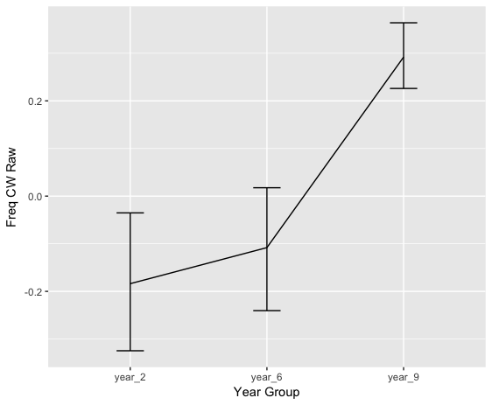
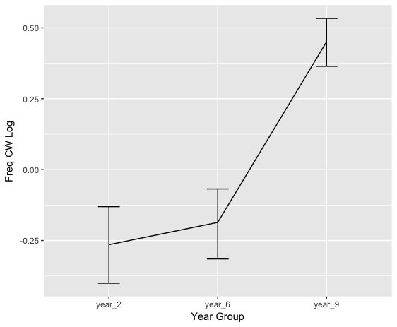
Content words
F(2, 654)=18.38, p < .001, ⍵²=.06
post-hoc (FDR correction): year 2 = year 6 < year 9
F(2, 654)=43.99, p < .001, ⍵²=.11
post-hoc (FDR correction): year 2 = year 6 < year 9

Slide 13
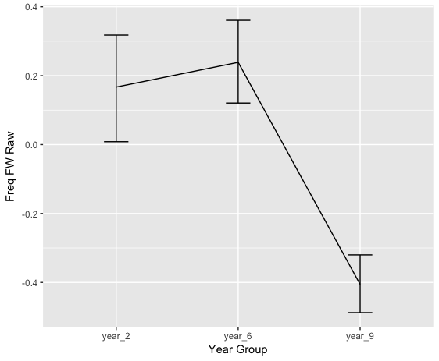
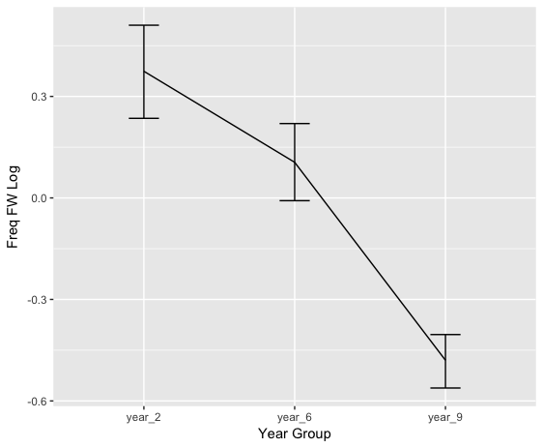
Function words
F(2, 654)=32.47, p < .001, ⍵²=.09
post-hoc (FDR correction): year 2 = year 6 > year 9
F(2, 654)=57.45, p < .001, ⍵²=.15
post-hoc (FDR correction): year 2 > year 6 > year 9
*Kyle & Crossley 2014

Slide 14
Ngram measures: Frequency & Association
Frequency: 7 x reference corpora; Association: 5 x reference corpora
Frequency: Raw vs. Log vs. Proportion
  Proportion: 10K; 20K; 30K…100K)
Association:
  MI, MI2; t-score; Delta-P; Collexeme
  Bigram vs. Trigram
    Trigram 1 (double – espresso please)
    Trigram 2 (double espresso – please)

Slide 15
Combining results from different corpora: Ngram proportions/frequencies
Category | Sub-category | Cronbach’s alpha | Deleted
Frequency | Bigram Proportion | 1
 | Bigram Log | .95
 | Trigram Proportion | 1
 | Trigram Log | .93 | BNC Spoken: .14 BNC Written: .20 COCA Academic: .65

Slide 16
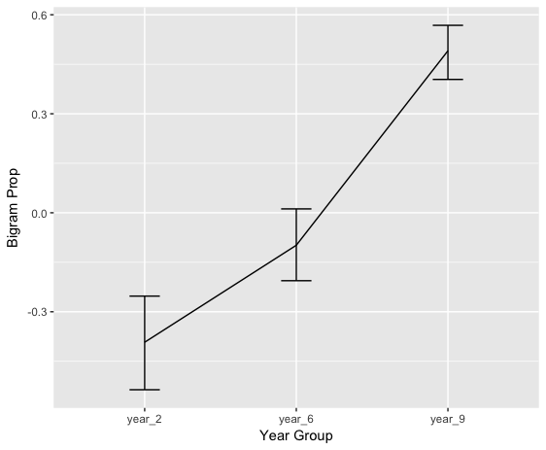
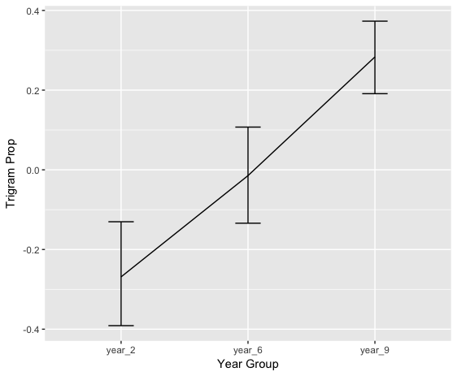
Proportions: Bigram & Trigram
F(2, 654)=58.43, p < .001, ⍵²=.15
post-hoc (FDR correction): year 2 < year 6 < year 9
F(2, 654)=21.38, p < .001, ⍵²=.06
post-hoc (FDR correction): year 2 < year 6 < year 9

Slide 17
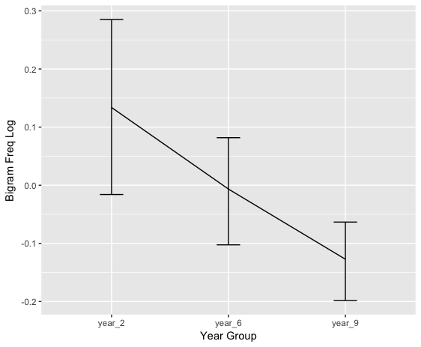
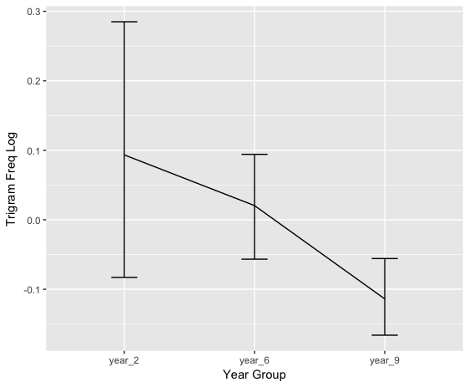
Frequency: Bigram & Trigram (Logs)
F(2, 654)=5.02, p < .01, ⍵²=.01
post-hoc (FDR correction): year 2 < year 9;
year 2 = year 6; year 6 = year 9
F(2, 654)=4.8, p =.055

Slide 18
Combining results from different corpora
Sub-category | Cronbach’s alpha | Deleted
Bigram / MI | .95
Bigram / MI2 | .95
Bigram t-score | .97
Bigram Delta-P | .97
Bigram Collexeme | .99

Slide 19
Combining results from different corpora
Sub-category | Cronbach’s alpha | Deleted
Trigram (1) / MI | .93 | COCA Academic: .59
Trigram (1) / MI2 | .91 | COCA Academic: .64
Trigram (1) / t-score | .94
Trigram (1) / Delta-P | .94
Trigram (1) / Collexeme | .93
Trigram (2) / MI | .95 | COCA Academic: .65
Trigram (2) / MI2 | .93 | COCA Academic: .62
Trigram (2) / t-score | .94 | COCA Fiction: .67
Trigram (2) / Delta-P | .94
Trigram (2) / Collexeme | .94 | COCA Academic: .68

Slide 20
 | 2G MI | 2G MI2 | 2G T | 2G DP | 2G Clex | 3G1 MI | 3G1 MI2 | 3G1 T | 3G1 DP | 3G1 Clex | 3G2 MI | 3G2 MI2 | 3G2 T | 3G2 DP | 3G2 Clex
2G MI | 1.00
2G MI2 | .61 | 1.00
2G T | .30 | .65 | 1.00
2G DP | .30 | .37 | .44 | 1.00
2G Clex | -.06 | .32 | .76 | .43 | 1.00
3G(1 MI | .45 | .05 | -.12 | .13 | -.24 | 1.00
3G1 MI2 | .39 | .36 | .23 | .22 | .08 | .67 | 1.00
3G1 T | .23 | .42 | .43 | .20 | .29 | .19 | .72 | 1.00
3G1 DP | .06 | .12 | .29 | .38 | .43 | .19 | .34 | .38 | 1.00
3G1 Clex | .13 | .36 | .39 | .21 | .35 | .09 | .60 | .91 | .43 | 1.00
3G2 MI | .46 | .07 | -.09 | .16 | -.19 | .65 | .47 | .14 | .13 | .09 | 1.00
3G2 MI2 | .43 | .33 | .20 | .24 | .07 | .49 | .80 | .61 | .26 | .53 | .73 | 1.00
3G2 T | .22 | .42 | .44 | .28 | .32 | .12 | .64 | .84 | .38 | .84 | .22 | .67 | 1.00
3G2 DP | .15 | -.01 | .11 | .49 | .19 | .34 | .35 | .24 | .49 | .24 | .44 | .43 | .31 | 1.00
3G2 Clex | .12 | .36 | .39 | .22 | .36 | .07 | .59 | .87 | .43 | .98 | .11 | .56 | .89 | .27 | 1.00

Slide 21
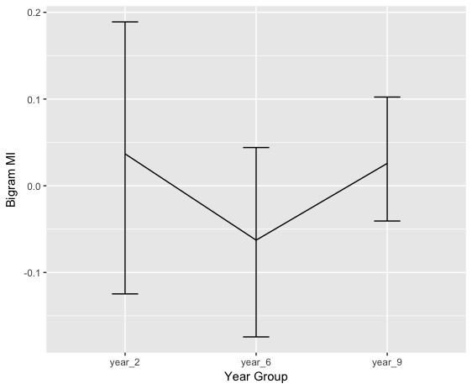
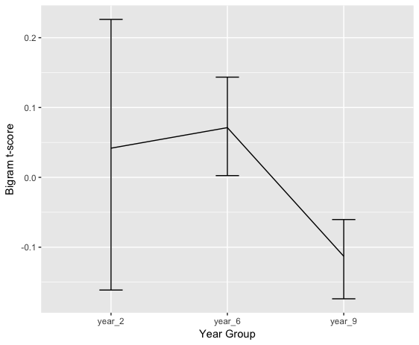
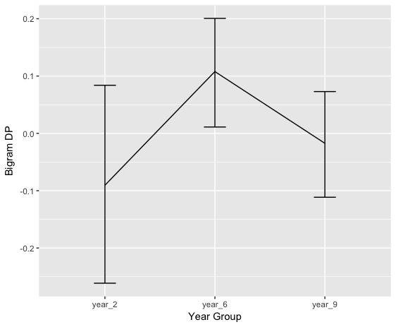
Bigram associations: MI; t-score; DP
F(2, 654)=0.79, p >.05
F(2, 654)=2.37, p >.05
F(2, 654)=2.44, p >.05

Slide 22
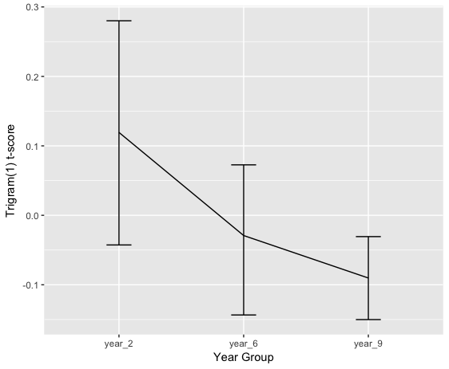
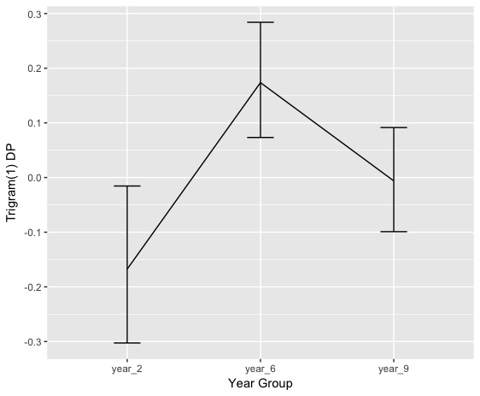
Trigram (1) associations: MI; t-score; DP
F(2, 654)=8.30, p < .001, ⍵²=.02
post-hoc (FDR correction):
year 2 = year 6 < year 9
F(2, 654)=3.17, p < .05, ⍵²=.01
post-hoc (FDR correction):
year 2 = year 6; year 6 = year 9
Year 2 < year 9
F(2, 654)=7.97, p < .001, ⍵²=.02
post-hoc (FDR correction):
year 2 = year 9; year 6 = year 9
year 2 < year 6

Slide 23
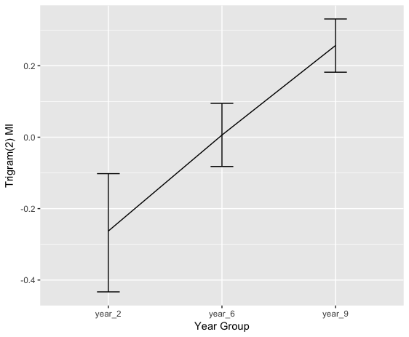
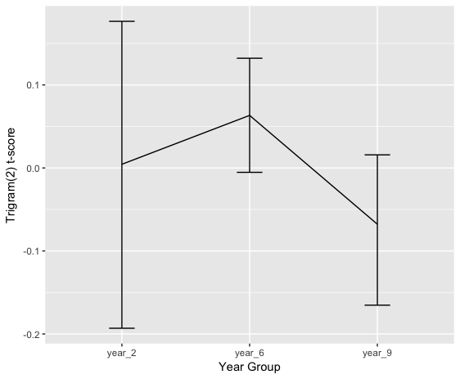
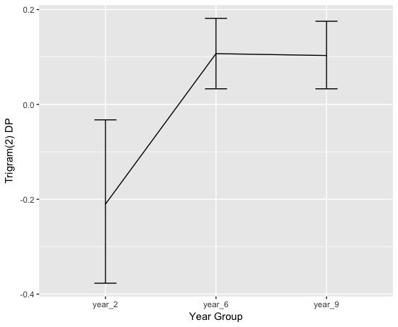
Trigram (2) associations: MI; t-score; DP
F(2, 654)=17.79, p < .001, ⍵²=.05
post-hoc (FDR correction):
year 2 < year 6 < year 9
F(2, 654)=1.11, p > .05
F(2, 654)=9.32, p < .001, ⍵²=.03
post-hoc (FDR correction):
year 2 < year 6; year 2 < year 9
Year 6 = year 9

Slide 24
Concreteness
Sub-category | Cronbach’s alpha
Content words | .95
Function words | .94

Slide 25
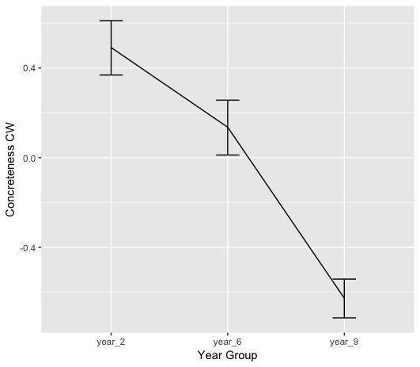
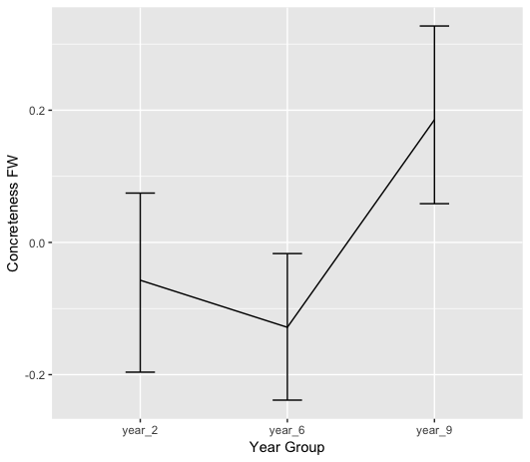
Concreteness
F(2, 654)=96.49, p < .001, ⍵²=.23
post-hoc (FDR correction): year 2 > year 6 > year 9
F(2, 654)=11.9, p < .005, ⍵²=.02
post-hoc (FDR correction): year 2 = year 6 < year 9

Slide 26
Conclusions - methodological
Counts from different reference corpora mostly consistent
Log frequencies enable patterns to emerge more clearly

Slide 27
Conclusions: frequency
Mean content word frequency increases with age
Mean function word frequency decreases with age

Slide 28
Conclusions: n-grams
Percentage of ngrams attested in corpora increases with age
Frequency of attested ngrams may decrease with age
MI & DP of attested trigrams increase with age
T-scores of attested trigrams decrease with age(?)

Slide 29
Conclusions - concreteness
Older children use more abstract content words
Older children use more concrete function words(?)

Slide 30
References
Crossley, S. A., Weston, J. L., Sullivan, S. T. M., & McNamara, D. (2011). The development of writing proficiency as a function of grade level: A linguistic analysis. Written Communication, 28, 282-311.
Kyle, K & Crossley, S. (2014). Automatically Assessing Lexical Sophistication: Indices, Tools, Findings, and Application. TESOL Quarterly, 49(4), 757-786.
Malvern, D., Richards, B. J., Chipere, N., & Duran, P. (2004). Lexical diversity and language development. Basingstoke: Palgrave Macmillan.
Massey, A. J., & Elliott, G. L. (1996). Aspects of Writing in 16+ English examinations between 1980 & 1994. Cambridge: University of Cambridge Local Examinations Syndicate.
Massey, A. J., Elliott, G. L., & Johnson, N. K. (2005). Variations in aspects of writing in 16+ English examinations between 1980 and 2004: Vocabulary, spelling, punctuation, sentence structure, non-standard English. Cambridge: Cambridge Assessment.
Olinghouse, N., G., & Leaird, J. T. (2009). The relationship between measures of vocabulary and narrarive writing quality in second- and fourth-grade students. Reading and Writing, 22, 545-565.
Olinghouse, N., G., & Wilson, J. (2013). The relationship between vocabulary and writing quality in three genres. Reading and Writing, 26, 45-65.
Read, J. (2000). Assessing Vocabulary. Cambridge: Cambridge University Press.
Roessingh, H., Elgie, S., & Kover, P. (2015). Using lexical profiling tools to investigage children's written vocabulary in grade 3: An exploratory study. Language Assessment Quarterly, 12(1), 67-86.

