Slide 1
Using expanded noun phrases for descriptive detail

Slide 2
LEAD Principles
PRINCIPLE | EXPLANATION | RATIONALE
LINKS | Make a link between the grammar being introduced and how it works in the writing being taught | To establish a purposeful learning reason for addressing grammar, and connect grammar with meaning and rhetorical effect
EXAMPLES | Explain the grammar through examples, not lengthy explanations | To avoid writing lessons becoming mini-grammar lessons, and to allow access to the structure even if the grammar concept is not fully understood
AUTHENTIC TEXTS | Use authentic texts as models to link writers to the broader community of writers | To integrate reading and writing and show how ‘real’ writers make language choices
DISCUSSION | Build in high-quality discussion about grammar and its effects | To promote deep metalinguistic learning about why a particular choice works, and to develop independence rather than compliance
Notes:
These are the key pedagogical principles which underpin the teaching. In the slides which follow, where the teaching is using these principles, they are shown in cream text boxes.
If you are not familiar with the principles you might like to listen to the PPT with audio which explains them.

Slide 3
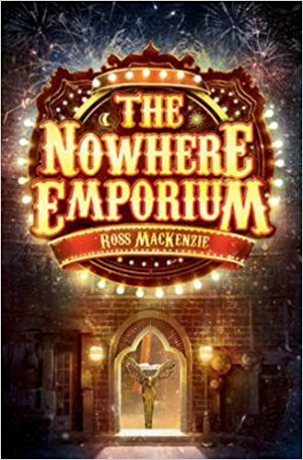
Authentic text
Noticing Details in a Text
the shop from nowhere
the mysterious building
bricks the colour of midnight
bricks that shimmered and sparkled under the glow of the gas streetlamps
the fine golden gate
a golden gate so fine and intricate that some wondrous spider might have spun it
a glimpse of movement through the darkened windows
a glimmer of movement in the entranceway
the door to a world of breathtaking magic and looming danger
Examples
Discussion
Look at the noun phrases that are used to describe the Nowhere Emporium. How well do they match the picture on the front cover of the book?
From the way it’s described, would you want to go inside this shop?
What objects do you think you might find inside?
Notes:
In initial discussion you could point out that:
the expanded noun phrases shown here (head noun indicated in bold) are used at the start of the novel to establish both setting and mood/atmosphere, and to entice the reader into a particular world
the expanded noun phrases provide visual images that help us imagine what is happening
they also provide information about the genre we are reading and help us make predictions and speculations, for example by making connections with our prior reading experience and our more general knowledge (e.g. what objects an ‘emporium’ might contain, and how one might differ from a mere ‘shop’).
You could check students’ understanding of the world the author is creating here by asking them to describe the objects they think might be inside. Are they in keeping with the setting and theme of ‘magic and danger’? Encourage students to imitate any of the patterns of noun phrases shown here, and to ‘borrow’ vocabulary e.g:
a peacock feather that shimmered and sparkled in the candlelight
notebooks containing mysterious spells
spiders’ webs so delicate that fairies might have spun them
a magic cloak the colour of midnight

Slide 4
Noticing Details in a Text
Examples
The shop was indeed built from bricks the colour of midnight, bricks that shimmered and sparkled under the glow of the gas streetlamps. Blocking the doorway was a golden gate so fine and intricate that some wondrous spider might have spun it. Over the windows, curling letters spelled out a name: The Nowhere Emporium.
There was a glimmer of movement in the entranceway and, a ripple of excitement passed through the crowd. And then silence fell – a silence so deep and heavy that it seemed to hang in the atmosphere like mist.
The shop’s door swung open. The fine golden gate turned to dust, scattering in the wind.
The air was suddenly alive with a hundred scents: the perfume of toasted coconut and baking bread; of salty sea air and freshly fallen rain; of bonfires and melting ice.
Discussion
How much of the descriptive detail is created through expanded noun phrases? Can you see where these are placed within a sentence?
How well do the noun phrases help you to visualise the emporium, imagine what is inside it and understand how the crowd react to it?
Links
Notes:
The extract from the Prologue to the novel shows some of the expanded noun phrase detail in context. In discussion you could point out:
that most of the description is adjectival, created through extended noun phrases (rather than through verbs and adverbials)
the flexibility of noun phrase units, with detail built before and after the head noun of the phrase (shown in bold) and occupying subject and object positions within a sentence; note the ‘layering’ effect where the whole noun phrase unit contains different noun phrases e.g: bricks that shimmered and sparkled under the glow of the gas streetlamps
different ways of building noun phrase detail as seen in the examples:
with determiners and adjectives, e.g: the fine golden gate; curling letters
with prepositional phrases e.g: the perfume of toasted coconut; a glimmer of movement /in the entranceway
with adverbial phrases e.g: a silence so deep and heavy; a golden gate so fine and intricate
with relative clauses e.g: bricks that shimmered and sparkled; a golden gate so fine and intricate that it seemed to hang…
why there is so much noun phrase descriptive detail – the ‘work’ that it does for us as readers. For example, it both pinpoints objects/sights/smells with precision (e.g: bricks that shimmered under the glow of the gas streetlamps; the perfume of salty sea air) and leaves space for us to use our imaginations (e.g: the fine golden gate; a glimmer of movement); the noun phrases suggest the crowd’s sense of puzzlement and wonder (e.g: a ripple of excitement; a silence so deep and heavy…) and help build our own curiosity about the sudden appearance of the Emporium and what it might contain.

Slide 5
Verbalising the Grammar-Writing Link
A crucial element of the LEAD principles is helping writers to think explicitly (metalinguistically) about the choices they make. As a teacher, you need to support this by being crystal clear yourself about how you verbalise the link between a grammar choice and its effect in a particular text/context. Then express this in student-friendly language, as below.
Verbalisation to share with students:
When you are describing a scene in narrative, you can help your reader visualise it by describing it in detail. You might choose to use expanded noun phrases that provide a detailed description.
Choose your noun phrases carefully!
Notes:
This is key: our research shows that teachers need to ‘practise’ verbalising the link for themselves; and then share it with students (and discuss it in the context of the students’ own writing).

Slide 6
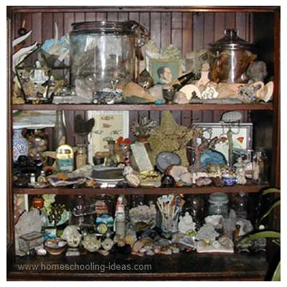
Invent and label objects in a cabinet of curiosities
an ancient cabinet of curious wonders from around the world
an antique clock with a cracked glass face
a specimen jar that contained a small wooden cross
a china doll’s head with piercing blue eyes
a miniature silver key so small that an elf might have fashioned it
Notes:
You might want to use this slide to consolidate learning.
Cabinets of curiosities, also known as 'wonder rooms’, or ‘wunderkammers’, were particularly popular in Victorian times. They were small collections of extraordinary objects which, like today's museums, attempted to categorise and tell stories about the wonders and oddities of the natural world. You could create labelled objects for your own cabinet of curiosities, modelling different patterns of expanded noun phrases (examples on the slide). These could be used in a writing task e.g.
Describe a visit to an old curiosity shop
Or
Write a story that starts with the discovery of an interesting or unusual object

