Slide 1
Varying sentence patterns and rhythms to emphasise meaning in narrative

Slide 2
LEAD Principles
PRINCIPLE | EXPLANATION | RATIONALE
LINKS | Make a link between the grammar being introduced and how it works in the writing being taught | To establish a purposeful learning reason for addressing grammar, and connect grammar with meaning and rhetorical effect
EXAMPLES | Explain the grammar through examples, not lengthy explanations | To avoid writing lessons becoming mini-grammar lessons, and to allow access to the structure even if the grammar concept is not fully understood
AUTHENTIC TEXTS | Use authentic texts as models to link writers to the broader community of writers | To integrate reading and writing and show how ‘real’ writers make language choices
DISCUSSION | Build in high-quality discussion about grammar and its effects | To promote deep metalinguistic learning about why a particular choice works, and to develop independence rather than compliance
Notes:
These are the key pedagogical principles which underpin the teaching. In the slides which follow, where the teaching is using these principles, they are shown in cream text boxes.
If you are not familiar with the principles you might like to listen to the PPT with audio which explains them.

Slide 3
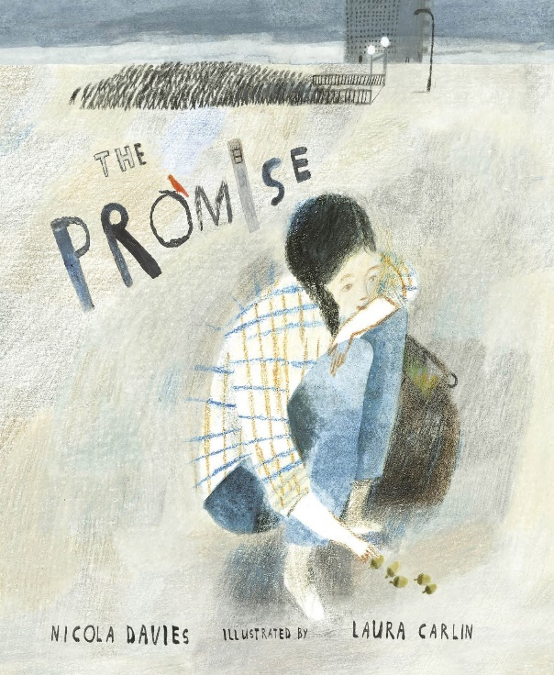
Noticing Patterns in a Text
Authentic text
When I was young I lived in a city that was mean and hard and ugly. Its streets were dry as dust, cracked by heat and cold, and never blessed with rain. A gritty, yellow wind blew constantly, scratching around the city like a hungry dog. Nothing grew. Everything was broken. No one ever smiled. The people had grown as mean and hard and ugly as their city and I was mean and hard and ugly too. I lived by stealing from those who had almost as little as I did. My heart was as shrivelled as the dead trees in the park.
Discussion
Read aloud the opening to The Promise by Nicola Davies. Would you like to live in this city? Give your reasons.
Can you find a phrase that is repeated three times? Why do you think the writer repeats this particular phrase?
Notes:
You can listen to Nicola Davies reading ‘The Promise’ at: https://vimeo.com/73026206
‘The Promise’ might be described as a modern fable or folk tale, so some of the repetition in it is linked to the conventions of the genre (objects or actions that occur in ‘threes’ being typical). Repetition of ‘mean and hard and ugly’ is applied to the city, its people and the protagonist, suggesting the strength of the need for transformation of the city and its inhabitants’ lives (by the end of the story this has been achieved by the planting of ‘magic’ acorns that grow into trees and gardens, making the city a green space and bringing people together).
You could ask students if they notice any other kinds of repetition in the opening paragraph and note how these produce a distinctive rhythm and mood, for example:
The number of monosyllabic words in phrases (mean and hard; dry as dust; cracked by heat and cold; the dead trees in the park) making the harsh sounds and rhythms more relentless
The number of co-ordinated phrases and clauses similarly adds to the idea of relentless tedium and inevitability, e.g. The people had grown as mean and hard and ugly as their city and I was mean and hard and ugly too
Choice of words with hard consonant sounds and/or from similar lexical field, to connote ugliness and harshness: mean, hard, ugly, dry, cracked, gritty, scratching, broken, shrivelled
Repeated negative constructions: never blessed with rain; nothing grew; no-one ever smiled
Three short sentences positioned in the middle of the paragraph stressing the bleak scene as simple fact: Nothing grew. Everything was broken. No one ever smiled.

Slide 4
Noticing Patterns in a Text
Authentic text
When I was young I lived in a city that was mean and hard and ugly. Its streets were dry as dust, cracked by heat and cold, and never blessed with rain. A gritty, yellow wind blew constantly, scratching around the city like a hungry dog. Nothing grew. Everything was broken. No one ever smiled. The people had grown as mean and hard and ugly as their city and I was mean and hard and ugly too. I lived by stealing from those who had almost as little as I did. My heart was as shrivelled as the dead trees in the park.
Links
Discussion
Prepare a choral reading of this opening to The Promise. Which words, phrases or sentences will you emphasise to bring out the ugliness of the city and the harshness of people’s lives in it? Experiment with the effects of using single and multiple voices or of varying volume and tone.
Notes:
You might want to support students’ performance by highlighting words, phrases or sentences for particular emphasis, eg picking up on the points from discussion of repeated patterns, as outlined on previous slide notes).
In preparation and feedback, you can emphasise the grammar-meaning link suggested in the instruction, reflecting on language choices that most emphasise the ugliness and harshness of the city.
The next slides look in more detail at some of the patterns that create strong rhythms and emphasise the main ideas.

Slide 5
Noticing Patterns in a Text
Examples
Nothing grew. Everything was broken. No one ever smiled.
The three very short factual sentences and the deliberate repetition of pronoun starts stress how unrelentingly dull and harsh life is across the city. Everything and everyone is affected and there seems to be no chance of escape to a better life.
Placing these three short sentences next to each other in the middle of the paragraph draws attention to them, slowing down the rhythm and making you focus on the message.
Links
Notes:
You can use the ‘mini scripts’ on the slide to model explanations of the effect of particular sentence patterns. Stress the context of the opening of ‘The Promise’ that lays out the ‘problem’ in the story that needs to be resolved. Try to avoid making generic comments about short sentences eg that ‘short snappy sentences create tension’. You can reflect on how these sentences were emphasised in students’ choral readings and if they agree that the rhythm slows at this point to ‘hammer home’ the central ‘problem’. You could try altering sentence construction to hear the rhythm of alternative choices e.g. ‘Nothing grew and everything was broken and no one ever smiled.’ Does this give as bleak a picture as the original, which gives more emphasis to the patterning of successive pronoun starts: Nothing..Everything…No one?

Slide 6
Noticing Patterns in a Text
Examples
The people had grown as mean and hard and ugly as their city and I was mean and hard and ugly too.
The heavy use of co-ordination, with ‘and’ used to join words into phrases and to join clauses, creates a deliberately repetitive rhythm in the sentence that stresses the relentless harshness of city life. It also shows that individual behaviour is directly linked to the ugly environment.
The phrase ‘mean and hard and ugly’ is repeated three times in the same paragraph in order to emphasise the ‘problem’ in the story that needs resolving. The city and its people must be restored to health and happiness.
Links
Notes:
You can use the ‘mini scripts’ on the slide to model explanations of the effect of particular sentence patterns. Try to avoid making generic comments about co-ordinated sentences e.g. that overusing ‘and’ sounds childish or boring. Note that Nicola Davies uses ‘and’ to join words into phrases and to join clauses. You could experiment with different choices e.g. ‘The people had grown as mean and hard and ugly as their city. And I was mean and hard and ugly too.’ Does punctuating the second clause as a separate sentence give extra emphasis to the link between surroundings and personal behaviour?

Slide 7
Noticing Patterns in a Text
Its streets were dry as dust, cracked by heat and cold, and never blessed with rain. A gritty, yellow wind blew constantly, scratching around the city like a hungry dog. .
Examples
The subordinate clauses aren’t essential to the meaning of these sentences but they add sensory detail, helping us to visualise the city streets and to establish through their imagery the atmosphere of harshness, ugliness and threat.
The subordinate clauses add richness to the rhythm and texture of the prose, reinforcing our view of the city through sound effects as well as imagery, for example by using harsh vowel and consonant sounds in words like cracked, cold, scratching, hungry, dog
Links
Notes:
You can use the ‘mini scripts’ on the slide to model explanations of the effect of particular sentence patterns. Try to avoid making generic comments about subordinate clauses e.g. that they ‘add information’. In the context of the opening to ‘The Promise’ you can stress how they strengthen the visual picture we get of the city, add auditory effects and reinforce the atmosphere of harshness and threat. You can experiment with alternative choices to compare effects e.g. whether writing the first sentence as three short single-clause sentences might create a deliberately disjointed effect that ‘works’ to convey the harsh atmosphere: ‘Its streets were dry as dust. They were cracked by heat and dust. They were never blessed with rain’ or is the original list of three clauses more successful in emphasising the harshness of the surroundings?

Slide 8
Verbalising the Grammar-Writing Link
A crucial element of the LEAD principles is helping writers to think explicitly (metalinguistically) about the choices they make. As a teacher, you need to support this by being crystal clear yourself about how you verbalise the link between a grammar choice and its effect in a particular text/context. Then express this in student-friendly language, as below.
Verbalisation to share with students:
When you are writing narrative, you can think about how you can create a particular message, mood or atmosphere. You might vary the patterns and rhythms of your sentences to emphasise their meaning.
Remember to read your sentences aloud to hear the rhythms and sound effects that you are creating.
Notes:
This is key: our research shows that teachers need to ‘practise’ verbalising the link for themselves; and then share it with students (and discuss it in the context of the students’ own writing).

Slide 9
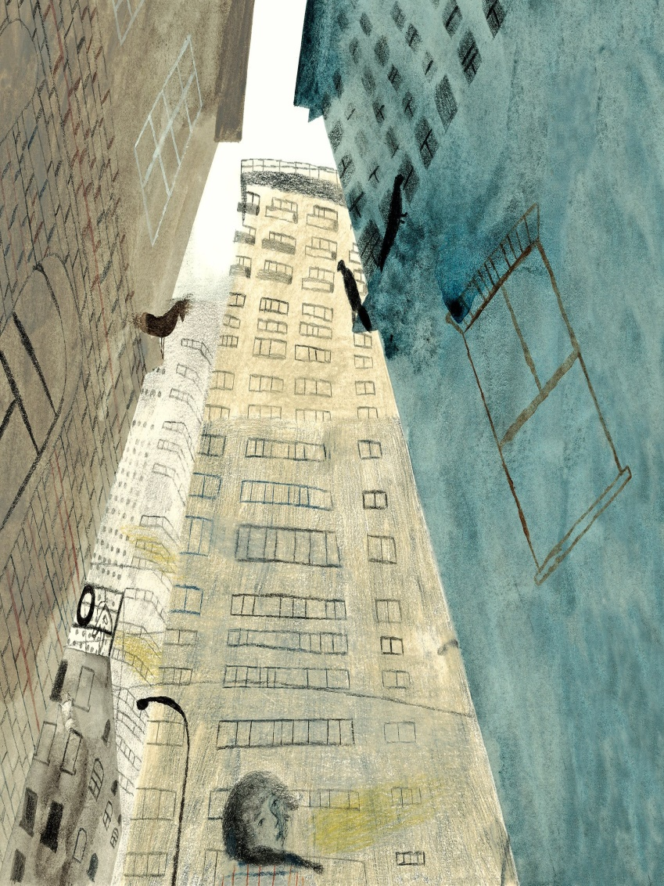
Ugly squat skyscrapers blocked out the light. They towered over me. They soared into the sky. They imprisoned me.
Experiment with different ways of rewriting and arranging these sentences. You can add your own sentences, using the picture to prompt ideas.
Your aim is to make the city sound harsh, ugly and threatening.
Read your writing aloud to hear the rhythm of the sentences you are creating.
Notes:
If you like, as consolidation, you could use the illustration from ‘The Promise’ and the sentence examples to encourage students to try out the different sentence patterns they have looked at on previous slides. Recap with students the choices they can make:
You can choose short or longer sentences and think about where to place them in a paragraph.
You can use co-ordination (e.g. with ‘and’) to emphasise how ideas are linked.
You can use subordinate clauses to provide layers of visual or auditory detail.

