Slide 1

Making language choices to write like a scientist

Slide 2
LEAD Principles
PRINCIPLE | EXPLANATION | RATIONALE
LINKS | Make a link between the grammar being introduced and how it works in the writing being taught | To establish a purposeful learning reason for addressing grammar, and connect grammar with meaning and rhetorical effect
EXAMPLES | Explain the grammar through examples, not lengthy explanations | To avoid writing lessons becoming mini-grammar lessons, and to allow access to the structure even if the grammar concept is not fully understood
AUTHENTIC TEXTS | Use authentic texts as models to link writers to the broader community of writers | To integrate reading and writing and show how ‘real’ writers make language choices
DISCUSSION | Build in high-quality discussion about grammar and its effects | To promote deep metalinguistic learning about why a particular choice works, and to develop independence rather than compliance
Notes:
These are the key pedagogical principles which underpin the teaching. In the slides which follow, where the teaching is using these principles, they are shown in cream text boxes.
If you are not familiar with the principles you might like to listen to the PPT with audio which explains them.

Slide 3
Writing like a Scientist
If you want to write like a scientist, some of the choices you can make are:
To use precise scientific vocabulary, especially nouns and verbs;
Expand your noun phrases to provide more detail and information;
Be direct in communicating information by using more sentences which start with a subject;
Use the universal present tense to indicate that this is a scientific fact which is true now as well as in the past;
Use appropriate Proper Nouns to name things and specific places;
Use adverbials, especially prepositional phrases, to provide information about where, when or how things happen.
Notes:
You can use this ‘big picture’ overview of language choices for scientific writing and then focus on those you think most appropriate for your students’ needs. The two texts used to illustrate scientific writing are shown on the next slide. Both are dual texts, with a lyrical narrative alongside the scientific writing, which can usefully prompt discussion of differences in language choices, as suggested on the next slide.

Slide 4
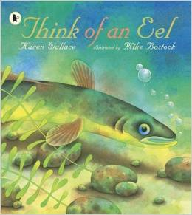
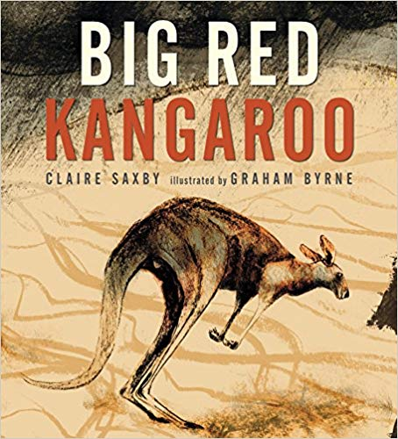
Dual Texts
A dual text conveys the same information in two different ways, and plays with authorial choice and different voices e.g the poet and the scientist;
This allows for direct comparisons of how the writer made grammar choices which communicate meaning in an appropriate way for each genre.

Slide 5
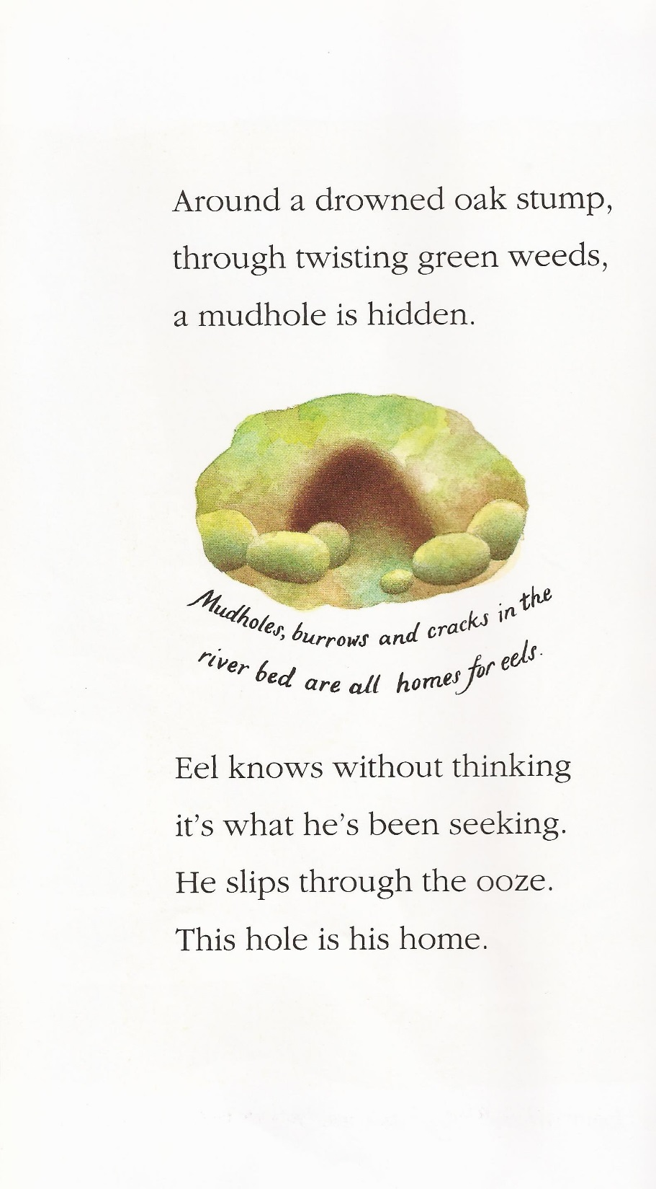
Writing like a Scientist
Authentic text
What are the language differences between the poetic text and the scientific text?
Discussion
Notes:
Think of an Eel by Karen Wallace is about the life cycle of the eel and alternates between a poetically written narrative and plainer factual text, often on the same page, as in the example on the slide.
Initial discussion of differences in style might bring out:
How the eel in the poetic text is presented as a specific personality, named as ‘Eel’, in the same way as a narrative might revolve around a particular character. Here, ‘eel’ is personified to engage the reader in his story e.g. ‘Eel knows without thinking it’s what he’s been seeking’. Compare with the more impersonal and objective information in the science text.
The succinct nature of the scientific text compared with the poetic narrative. seen in the factual listing of places where eels go to spawn – ‘mudholes, burrows and cracks in the river bed’ – compared with the detailed description in the prepositional phrases – ‘around a drowned oak stump, through twisting green weeds...’ The delaying of the subject (‘the mudhole’) in this sentence is a deliberate rhetorical device typical of narrative, for example in the painting of a detailed picture of a setting.

Slide 6
Noticing Details in a Text
Examples
Links
Poetic text:
The elaborate prepositional phrases create descriptive detail which paints a vivid picture of the eel’s breeding grounds for the reader;
The deliberate delaying of the subject in the main clause adds a sense of mystery about where the eel breeds;
The choice of ‘drowned ‘ and ‘twisting’ emphasise the secrecy of the eel’s breeding place and help create the lyrical rhythm of the sentence, perhaps making it more memorable?
Scientific text:
The subject start to the sentence is more direct, so the reader knows the topic straight away and the tone is factual and authoritative;
Noun choices - ‘mudholes’ ‘burrows’, ‘cracks’ – makes precise where eels breed, while prepositional phrase ‘in the river bed’ specifies further where eels live.
Notes:
In discussing language choices more closely, it will be helpful to stress with students how these link to meaning and effect, depending on the purpose of the text and its genre. The dual text isn’t privileging one set of choices over another but rather illustrating the flexibility of language in presenting information in different ways.
You could explore with students what is gained in the scientific text and what is lost, in terms of the information provided about the eel.

Slide 7
Making Language Choices
Authentic text
Examples
After eighty days’ swimming, not eating, not sleeping, eel’s long, winding body is worn out and wasted. He spills the new life carried deep in his belly, then sinks through the sea like a used silver wrapper.
Collaborative Writing in Pairs:
Rewrite this extract like a scientist
The eel swims for eighty days, with no food or sleep, and loses his body strength. When he reaches the Sargasso Sea, the male fertilizes the female’s eggs, and then dies.
What transformations have you made to alter the lyrical description into a scientific description? Could any other changes be made?
Links
Discussion
Notes:
You could use these short writing and talk tasks to encourage reflection on how language choices alter meaning and effect, and to consolidate understanding of the choices that make scientific writing objective, factual and precise.
The text in red is a teacher model, to encourage comparison with students’ choices. The original ‘scientific text’ at this point in the book is this: The male eel’s sperm fertilizes the female’s eggs in the water.
In discussion, you might bring out the contrast between:
The use of metaphor and simile in the poetic text which is a more indirect way of communicating information and requires inference from the reader e.g ‘the new life carried deep in his belly’’ ‘sinks like a used silver wrapper’; whereas information is conveyed more factually and directly in the scientific text;
The rhetorical devices in the poetic text which create emotive engagement with the subject e.g. the repetition of ‘not eating, not sleeping’, the alliterative coupling of ‘worn out and wasted’’, compared with the more factual and impersonal language of the scientific text;
The subject start in the scientific text, which keys the reader immediately to the point: ‘The male fertilizes …’ compared with the delayed subject (‘eel’s …body is wasted’) in the poetic text;
The use of scientific vocabulary: ‘fertilizes the female’s eggs’ ; ‘loses his body strength’ ; as opposed to poetic imagery, ‘spills the new life’; ‘is worn out and wasted’

Slide 8
Noticing Details in a Text
The heat eases with approaching nightfall. It is breakfast time for Red’s mob. Around them, the night orchestra begins. Red rises and leads his mob beyond the shadow line in search of grasses.
Red kangaroos are most active at dusk and dawn, although they will graze throughout the night.
The grasses are difficult for their stomachs to digest. When they rest, they sometimes regurgitate their food and chew it again.
What differences are there between the language choices in the narrative and the scientific text?
Notes:
The dual text shown here is Big Red Kangaroo by Claire Saxby, illustrated by Graham Byrne. It contrasts a narrative about a ‘named’ kangaroo, Red, with a factual scientific account of kangaroos in their habitat.
You can invite students to verbalise language differences, encouraging them to suggest why the two kinds of texts are different in terms of their purpose and how the reader engages with them.

Slide 9
Writing like a Scientist
If you want to write like a scientist, some of the choices you can make are:
To use precise scientific vocabulary, especially nouns and verbs;
Expand your noun phrases to provide more detail and information;
Be direct in communicating information by using more sentences which start with a subject;
Use the universal present tense to indicate that this is a scientific fact which is true now as well as in the past;
Use appropriate Proper Nouns to name things and specific places;
Use adverbials, especially prepositional phrases, to provide information about where, when or how things happen.
Notes:
A reminder of the ‘big picture’ overview of writing like a scientist. You can use this to frame feedback from the discussion task on the previous slide, using examples from The Big Red Kangaroo dual text.
The next slides focus in on:
the use of precise scientific vocabulary, especially nouns and verbs
the use of universal present tense to indicate this is a scientific fact which is true now as well as in the past
expansion of noun phrases to provide precise detail and information

Slide 10
Writing like a Scientist
The heat eases with approaching nightfall. It is breakfast time for Red’s mob. Around them, the night orchestra begins. Red rises and leads his mob beyond the shadow line in search of grasses.
Look at the verbs (in green) in this narrative and scientific account. What differences can you see?
Narrative:
eases; begins; rises; leads
Lexical verbs to describe actions and events in narrative sequence.
Scientific:
graze; digest, rest, regurgitate; chew
Lexical verbs to describe different kinds of eating processes.
Red kangaroos are most active at dusk and dawn, although they will graze throughout the night.
The grasses are difficult for their stomachs to digest. When they rest, they sometimes regurgitate their food and chew it again.
Notes:
The highlighted lexical verbs are the ones that you would look up in a dictionary; the ‘action’ verbs that carry the weight of meaning.
Note the technical terms in the lexical verbs chosen for the scientific text: graze, digest, regurgitate and how these make the text sound authoritative, contributing to ‘the voice of an expert’.

Slide 11
Writing like a Scientist
Kangaroos are only found in Australia and Papua New Guinea. They are a diverse family, with more than sixty different species, and live in a wide range of habitats from wet rainforests through to dry plains.
Kangaroos are marsupials – their young are born undeveloped and then continue to grow in their mothers’ pouches.
Their family name ‘macropod’ means ‘big foot’. The biggest of all macropods is the red kangaroo. They live in the hot, dry inland of Australia where food can be scarce and water even more so.
Look at the verbs in green. What do you notice about the verb tense?
Why do you think scientific accounts like this are written in the present tense?
Notes:
Note the number of ‘be’ and ‘have’ verbs that scientific texts use to indicate the universal present (an ongoing situation that is generally applicable). You might want to use the term ‘finite verbs’ to highlight that these are the ones that change tense; in a verb phrase (‘are born’; ‘continue to grow’) the first verb is finite. You can substitute past tense verbs (were, lived, continued, meant etc) to help students see why these are inappropriate for a scientific account where the facts still hold true.
Modal verbs (can, could, might, would, may, will, shall, should) don’t themselves have a tense but combine with other words to indicate different aspects of tense e.g could be seen; might have been seen; would have lived etc. In the example here (‘can be’) you might want to draw attention to the difference between ‘where food is scarce’ and ‘where food can be scarce’. Both signal the universal present (i.e. situations/events that are ongoing and generally applicable) but the latter might suggest that conditions are slightly more changeable.

Slide 12
Writing like a Scientist
The heat eases with approaching nightfall. It is breakfast time for Red’s mob. Around them, the night orchestra begins. Red rises and leads his mob beyond the shadow line in search of grasses.
Look at the nouns and noun phrases (in red) in this narrative and scientific account. What differences can you see?
Narrative:
approaching nightfall, breakfast time, Red’s mob; the night orchestra; the shadow line
Noun phrase choices for imaginative and atmospheric description
Scientific:
red kangaroos, dusk, dawn, the grasses, their stomachs; their food
Scientific nouns and noun phrases for factual precision and succinctness.
Red kangaroos are most active at dusk and dawn, although they will graze throughout the night.
The grasses are difficult for their stomachs to digest. When they rest, they sometimes regurgitate their food and chew it again.
Notes:
Differences are both in choice of nouns and in the type of descriptive detail provided by the noun phrases, with the narrative account making deliberate rhetorical choices e.g the metaphor of ‘the night orchestra’, designed to engage the reader with the story of one particular group of kangaroos. Note the informality of ‘mob’ which is more appropriate in narrative than in a more formal factual scientific text. As with the previous writing task on ‘Think of an Eel’, you could encourage students to rewrite the narrative as a scientific text or vice versa, noticing the different language choices they make.
Note that ‘red kangaroo’ is a particular species (Macropus rufus) and that sometimes the name of the species is capitalised (compare with White Rhino or Grey Seal).

Slide 13
Writing like a Scientist
Kangaroos are only found in Australia and Papua New Guinea. They are a diverse family, with more than sixty different species, and live in a wide range of habitats from wet rainforests through to dry plains.
Kangaroos are marsupials – their young are born undeveloped and then continue to grow in their mothers’ pouches.
Their family name ‘macropod’ means ‘big foot’. The biggest of all macropods is the red kangaroo. They live in the hot, dry inland of Australia where food can be scarce and water even more so.
What do you notice about the nouns in red?
Australia, Papua New Guinea
Proper Nouns for naming specific places
marsupials, macropods, habitats, rainforests, young
Nouns for specific and succinct factual and technical information
Notes:
Note the importance of choosing vocabulary that sounds ‘expert’ e.g ‘marsupials’, ‘macropods’, ‘habitats’, ‘young’, the key nouns for the topic. You might encourage students to scan the text for these key nouns and use them to verbally summarise what the text is about.

Slide 14
Writing like a Scientist
Kangaroos are only found in Australia and Papua New Guinea. They are a diverse family, with more than sixty different species, and live in a wide range of habitats from wet rainforests through to dry plains.
Kangaroos are marsupials – their young are born undeveloped and then continue to grow in their mothers’ pouches.
Their family name ‘macropod’ means ‘big foot’. The biggest of all macropods is the red kangaroo. They live in the hot, dry inland of Australia where food can be scarce and water even more so.
What do you notice about the expanded noun phrases in red?
a diverse family; a wide range of habitats, their mother’s pouches
Expanded noun phrases for detailed and specific information about the kangaroos’ features and environment
Notes:
You can draw attention to how expanded noun phrases are used to clarify and specify e.g. to indicate size and extent: ‘the biggest of all macropods’; ‘more than sixty different species’; ‘their mother’s pouches’.
You can also draw attention to the variety of noun phrase constructions that are used to convey detail succinctly, using the examples as models for imitation e.g from simple pre-modifying adjectives: ‘wet rainforests’; ‘dry plains’ to post-modifying prepositional phrases that specify place e.g ‘the hot, dry inland of Australia’

Slide 15
Verbalising the Grammar-Writing Link
A crucial element of the LEAD principles is helping writers to think explicitly (metalinguistically) about the choices they make. As a teacher, you need to support this by being crystal clear yourself about how you verbalise the link between a grammar choice and its effect in a particular text/context. Then express this in student-friendly language, as below.
Verbalisation to share with students:
When you are writing like a scientist, you can help your reader to trust what you say by sounding like an expert on the subject. Your writing needs to be succinct, precise, factual and authoritative.
Think about how you can:
use precise specific vocabulary, especially nouns and verbs
use verbs in the present tense to indicate universal scientific facts
expand your noun phrases to provide precise detail and information

