Slide 1
Positioning the reader through language choices: Dickens’ description of Coketown
Notes:
The notion of a writer ‘positioning’ the reader can be helpful in focusing students’ attention on the deliberate nature of language choices. Texts are crafted or shaped using a range of techniques designed to encourage readers to endorse the writer’s ideas, values and attitudes, and this applies as much to fiction as to argument writing, for example in how readers are positioned to be sympathetic or unsympathetic to characters. The focus in these slides is on how Dickens shapes the reader’s perspective in the construction of the setting of Coketown in ‘Hard Times’. The fictional city of Coketown is a stand-in for real life industrial mill towns, inspired by places like Preston, a town that Dickens visited shortly before writing the novel in 1854. Dickens’ description of Coketown as a living hell positions the reader to share his view of the human costs of industrialisation.

Slide 2
LEAD Principles
PRINCIPLE | EXPLANATION | RATIONALE
LINKS | Make a link between the grammar being introduced and how it works in the writing being taught | To establish a purposeful learning reason for addressing grammar, and connect grammar with meaning and rhetorical effect
EXAMPLES | Explain the grammar through examples, not lengthy explanations | To avoid writing lessons becoming mini-grammar lessons, and to allow access to the structure even if the grammar concept is not fully understood
AUTHENTIC TEXTS | Use authentic texts as models to link writers to the broader community of writers | To integrate reading and writing and show how ‘real’ writers make language choices
DISCUSSION | Build in high-quality discussion about grammar and its effects | To promote deep metalinguistic learning about why a particular choice works, and to develop independence rather than compliance
Notes:
These are the key pedagogical principles which underpin the teaching. In the slides which follow, where the teaching is using these principles, they are shown in cream text boxes.
If you are not familiar with the principles you might like to listen to the PPT with audio which explains them.

Slide 3
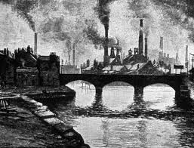
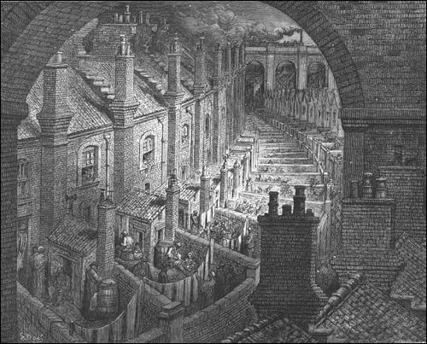
What strikes you most about these industrial towns of the 1850s?
Would these kind of scenes exist today?
Notes:
If helpful, you can use the images to orientate students to the social and historical context of Dickens’ novel. You could invite comparison with contemporary industrial towns and cities to emphasise some of the social and environmental changes that have taken place since Dickens was writing, as well as some of the problems that still exist.

Slide 4
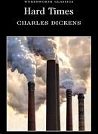
It was a town of red brick, or of brick that would have been red if the smoke and ashes had allowed it; but as matters stood, it was a town of unnatural red and black like the painted face of a savage. It was a town of machinery and tall chimneys, out of which interminable serpents of smoke trailed themselves for ever and ever, and never got uncoiled. It had a black canal in it, and a river that ran purple with ill-smelling dye, and vast piles of building full of windows where there was a rattling and a trembling all day long, and where the piston of the steam-engine worked monotonously up and down, like the head of an elephant in a state of melancholy madness. It contained several large streets all very like one another, and many small streets still more like one another, inhabited by people equally like one another, who all went in and out at the same hours, with the same sound upon the same pavements, to do the same work, and to whom every day was the same as yesterday and to-morrow, and every year the counterpart of the last and the next.
Authentic text
Discussion
How should the reader react to Dickens’
description of Coketown?
Notes:
‘How should the reader react?’ relates to the notion of reader positioning. In initial discussion of how Dickens shapes the reader’s point of view or perspective, you might point out:
how the name of the town stresses the reason for its existence - it’s been directly created to serve the new industries and there is nothing natural about it
the vivid sensory description – Dickens concentrates on the unpleasant and unnatural sights, sounds and smells of the town, selecting details that make Coketown seem like a scene from hell
the imagery that makes comparisons with unnatural, brutal or fearful creatures – the painted savage, serpents, mad elephant
the repetitive sentence structures, underlining the ‘interminable’ or monotonous nature of people’s lives
The following slides consider these points in more detail, in order to answer the question of what the reader can infer about Dickens’ viewpoint on industrialisation from this description. Keep the writer’s intentions and purpose to the foreground as you look at the detail, emphasising that Dickens is making a social comment about the costs of industry in human terms by showing the everyday surroundings of people who might be termed ‘factory fodder’. In his own times, we might infer that Dickens wanted to raise the consciousness of his Victorian readers by making this description so vivid, lest they take for granted how their goods are produced. How should we react as contemporary readers?
The next slides focus on some of the deliberate language choices that position the reader to view Coketown through this perspective.

Slide 5
Noticing Details in a Text
Examples
It was a town of red brick, or of brick that would have been red if the smoke and ashes had allowed it; but as matters stood, it was a town of unnatural red and black like the painted face of a savage.
It was a town of machinery and tall chimneys, out of which interminable serpents of smoke trailed themselves for ever and ever, and never got uncoiled.
It had a black canal in it, and a river that ran purple with ill-smelling dye, and vast piles of building full of windows where there was a rattling and a trembling all day long, and where the piston of the steam-engine worked monotonously up and down, like the head of an elephant in a state of melancholy madness. …
Discussion
How does Dickens’ description appeal to the reader’s senses of sight, sound and smell?
What do these vivid sensory details tell us about life in Coketown?
How should the reader react?
Links
Notes:
In discussion you might bring out:
the visual impact of the description with the harsh, unnatural colours, smoke and ashes, painting a vision of hell
the monotony of the townscape, with ‘interminable’ rows of chimneys and indistinguishable ‘vast piles of building’ stressing functionality at the expense of aesthetics and effectively trapping its inhabitants
actual and implied references to the ‘ill-smelling’ atmosphere and the implications for the health of Coketown’s inhabitants, forced to breathe its smoke ‘for ever and ever’
actual and implied references to the incessant noise, again emphasising there is no respite for the workforce; all their senses are assaulted to the point where it is a
how the sensory description builds in intensity throughout the description, through deliberate repetition of key words and their synonyms across sentences and through progressively expanded noun phrases, where detail is reinforced through the addition of striking comparisons; in effect, the negative aspects of Coketown are ‘ratcheted up’ as we read, for example:
‘the smoke and ashes….interminable serpents of smoke trailed themselves for ever and ever’
‘a town of red brick…a town of unnatural red and black like the painted face of a savage’
‘a town of machinery and tall chimneys…and vast piles of buildings full of windows where there was a rattling and trembling all day long and where the piston of the steam-engine worked monotonously up and down, like the head of an elephant in a state of melancholy madness’

Slide 6
Noticing Details in a Text
Examples
It contained several large streets all very like one another, and many small streets still more like one another, inhabited by people equally like one another, who all went in and out at the same hours, with the same sound upon the same pavements, to do the same work, and to whom every day was the same as yesterday and to-morrow, and every year the counterpart of the last and the next.
Discussion
How has Dickens made this sentence so long and so repetitive?
What does the repetitive nature of this sentence reinforce about life in Coketown?
How should the reader react?
Links
Notes:
In discussion you might bring out:
the number of phrases and co-ordinated clauses joined with ‘and’, so that the rhythmic patterning of the sentence (and its length itself) reinforces the idea of the interminable monotony of lives and actions; a view of people as machines stuck in repetitive routines
repetition and intensification of similar phrases suggesting the uniformity of people’s surroundings and dullness of daily routines – ‘streets very like one another…still more like one another…people equally like one another’; ‘at the same hours…with the same sound upon the same pavements, to do the same work’
the repeated references to time, highlighting that the sole purpose of existence is work rather than pleasure: ‘every day…yesterday and tomorrow…every year…the last and the next’
the plain, non-figurative or expressive vocabulary, highlighting lack of creativity in people’s lives: ‘large…small…like…same…in…out’, coupled with number of monosyllabic words so that there is a metronomic beat rather than richer textual rhythms

Slide 7
Through his description of Coketown in ‘Hard Times’, what does Dickens want the reader to think and feel about industrialisation?
It was a town of red brick, or of brick that would have been red if the smoke and ashes had allowed it; but as matters stood, it was a town of unnatural red and black like the painted face of a savage. It was a town of machinery and tall chimneys, out of which interminable serpents of smoke trailed themselves for ever and ever, and never got uncoiled. It had a black canal in it, and a river that ran purple with ill-smelling dye, and vast piles of building full of windows where there was a rattling and a trembling all day long, and where the piston of the steam-engine worked monotonously up and down, like the head of an elephant in a state of melancholy madness. It contained several large streets all very like one another, and many small streets still more like one another, inhabited by people equally like one another, who all went in and out at the same hours, with the same sound upon the same pavements, to do the same work, and to whom every day was the same as yesterday and to-morrow, and every year the counterpart of the last and the next.
Notes:
Students might work in pairs to produce a verbal ‘essay-style’ response to the question, bringing together points made during discussion of previous slides. You can stress the notion of a writer ‘positioning the reader’ i.e. shaping the reader’s response through deliberate language choices.

Slide 8
Verbalising the Grammar-Writing Link
A crucial element of the LEAD principles is helping writers to think explicitly (metalinguistically) about the choices they make. As a teacher, you need to support this by being crystal clear yourself about how you verbalise the link between a grammar choice and its effect in a particular text/context. Then express this in student-friendly language, as below.
Verbalisation to share with students:
When you are writing fiction, you can think about how you want your reader to react to what you are showing them. Think carefully about what you want your reader to think and feel and make language choices with these intentions firmly in mind.
Notes:
This is key: our research shows that teachers need to ‘practise’ verbalising the link for themselves; and then share it with students (and discuss it in the context of the students’ own writing).

Slide 9
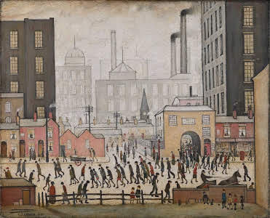
Write a description of the industrial town shown in this painting by J.S. Lowry. Your aim is to show either the negative or the positive effects of industry on the town’s inhabitants.
Notes:
If you like, you can use the painting as a stimulus for students’ own written description of an industrial town, choosing either a perspective similar to Dickens’ or a perspective that emphasises the advancements of industry and the purposeful contributions of its workers. You can use the description of Coketown as a model for students’ own writing, for example to encourage deliberate repetition of vocabulary and sentence structures to reinforce ideas and shape the reader’s perspective.

